Slide 1


Nexstep Commercial Products
(Exclusive Licensee of O-Cedar)

Slide 2


About Us
Most prominent manufacturer of cleaning tools in the US*
The brand you know and trust, set cleaning standard over 100 years
  85% brand recognition
  3-to-1 end-users recognize the O-Cedar over Rubbermaid*
Nexstep Commercial Products: separate company in 2003
  ONLY company using O-Cedar Logo in commercial marketplace
Privately-held, family-owned business – flexible and fast to respond
Fill Rate: ship at 99% complete each month
Lead Time: 72 hours (+1 day for private labels)
Limit your competition against non-stocking distributors
  NOT distributed directly to Lagasse, R3, or RJ Schinner
  NOT sold at Home Depot, Lowes, etc.
*Gallup survey b/o un-aided recall

Slide 3

Sustainability Focus
Committed to protecting the environment & improving the current state of Earth’s ecosystem
  Improved production facilities
    Increased energy efficiencies
  “Greener” practices
    Enhanced our customers’ competitiveness/costs
  Our products and packaging demonstrate our continued commitment to the environment

Slide 4

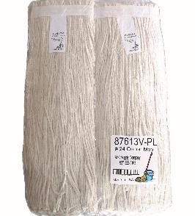
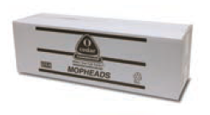
WET MOP Packaging
Flat-Pak™ Mop Carton
Overwrap Mop Packaging
Reduces mop carton size by 45%
Made from 100% recycled pulp; reduces waste
Standard Packaging on all Wet Mops
Overwrap compact packaging creates less waste
Eliminates all corrugated materials – Green Choice
Up to $0.10 savings per mop!

Slide 5
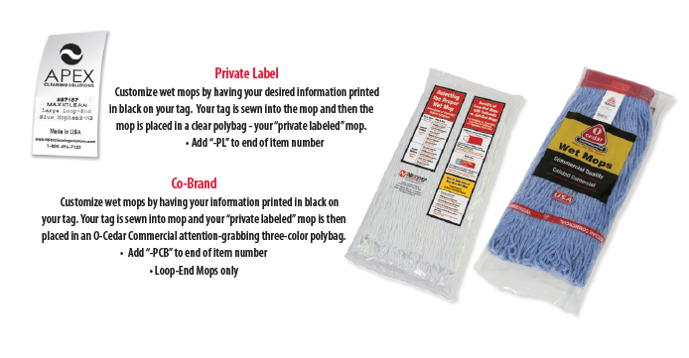
PRIVATE LABEL & PRIVATE CO-BRAND
  Minimum Order Requirements
  by Category
  • Loop-End Mops: 72 each / 6 dozen
  • Cut-End Mops: 144 each / 12 dozen
  • Angle Brooms: 288 each / 24 dozen
  • Lobby Dust Pans: 144 each / 12 dozen
  • Mopsticks: 144 each / 12 dozen
  • Corn Brooms: 288 each / 24 dozen
  • Mop Bucket & Wringers Case Label only: Pallet

Slide 6

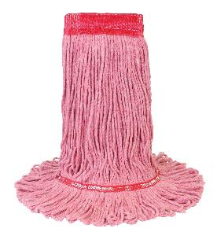
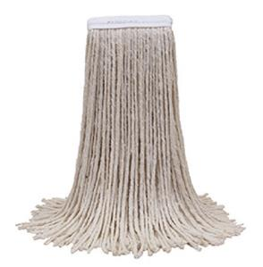
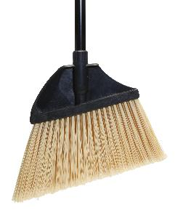
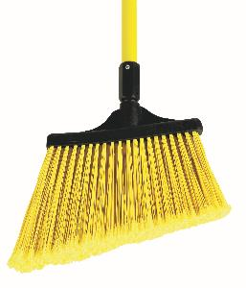
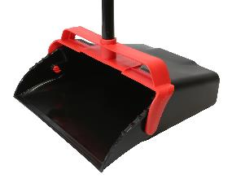
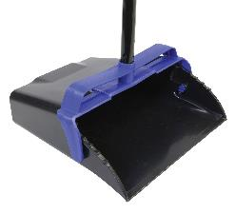
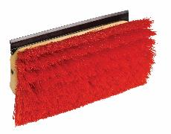
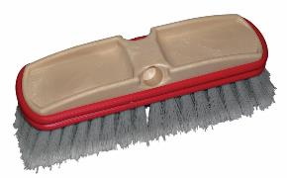
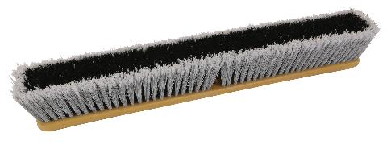
Over 70% of our products are
Made in the USA
Includes:
Wet Mops
Angle Brooms
Lobby Dust Pans
Brushes
Floor Sweeps
Wet Mops
Angle Brooms
Lobby dust pans
Brushes
Floor sweeps
AUTOMATION gives us our competitive advantage to stay COMPETITIVE and MADE IN USA !

Slide 7
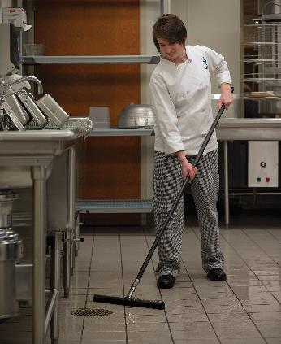
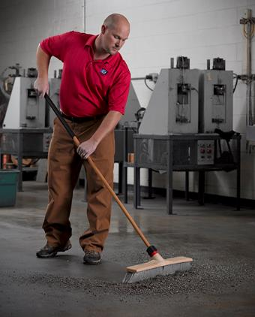

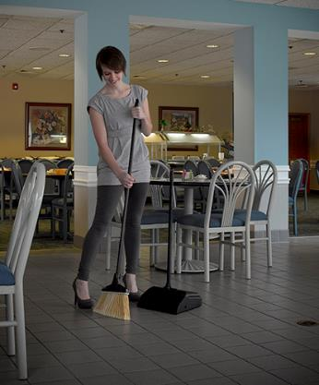
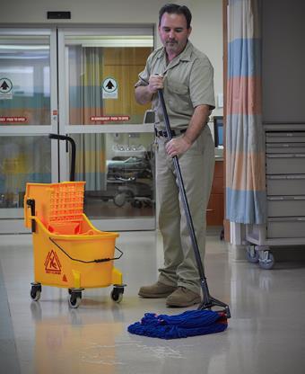
Product Line:
  Microfiber
  Wet Mops
  Mopsticks
  Mop Bucket & Wringers
  Cleaning Equipment
  Waste Containers
  Dust Mops
  Angle Brooms
  Dust Pans
  Floor Sweeps
  Brushes
  Handles
  Bathroom Accessories
  Squeegees & Scrapers
  Sponges & Pads
  Dusters
  Corn Brooms
  Rotaries
  Market Segments
  Jan/San
  Foodservice
  Healthcare
  Industrial
  Education
  Hospitality
  Convenience Stores
  Building Service Contractor

Slide 8

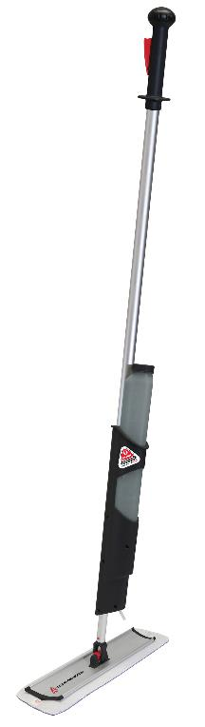

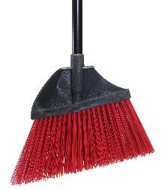
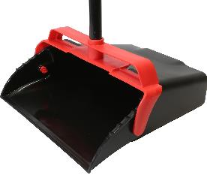
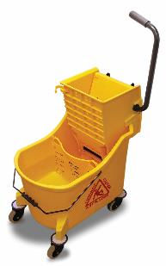
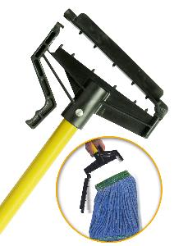
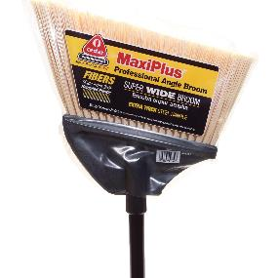
Our Innovative, exclusive Products
MaxiPlus® Lobby
Dust Pan
MaxiPlus® Microfiber
Loop End-Mop
MaxiPlus® Professional Angle Broom, Unflagged
MaxiPlus® Mop
Bucket & Wringer
Quick Change™
Mopstick
MaxiPlus® Professional Angle Broom, Flagged
MaxiPlus® All-in-One Cleaning System

Slide 9
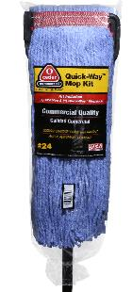
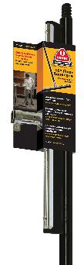
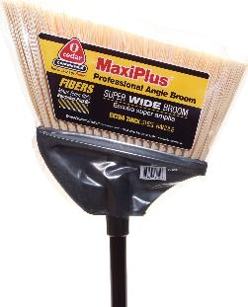
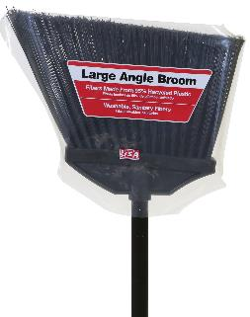
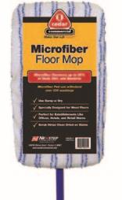
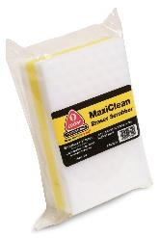
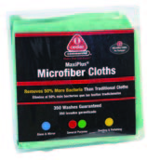
Cash n’ Carry packaging
Features the brand you know and trust...O-Cedar Commercial
Colorful, Attention-Grabbing
Bilingual Features, Advantages & Benefits
Self-Hanging & Shelf-Friendly - UPC bar coded

Slide 10

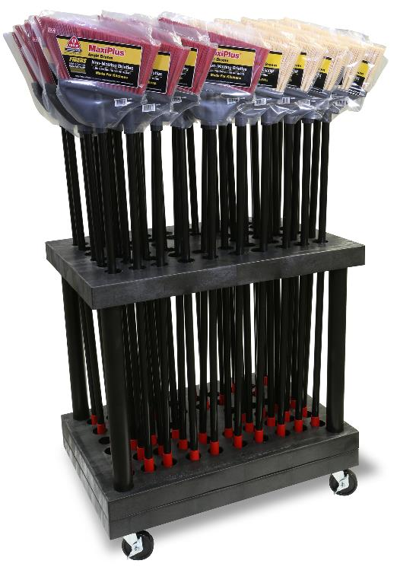
Long Handle Display Cart
Showroom standouts
Microfiber Cleaning Station

Slide 11
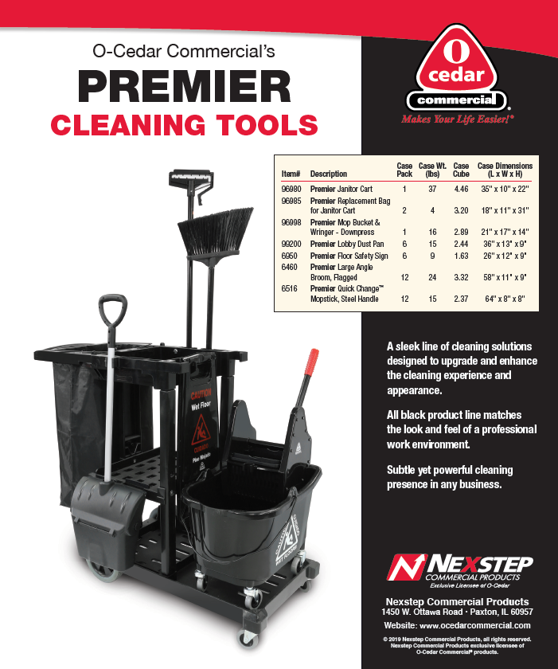
PREMIER
Cleaning Tools
Sleek cleaning solutions designed to upgrade and enhance the cleaning experience and appearance.
Subtle yet powerful cleaning presence in any business.
Available NOW

Slide 12
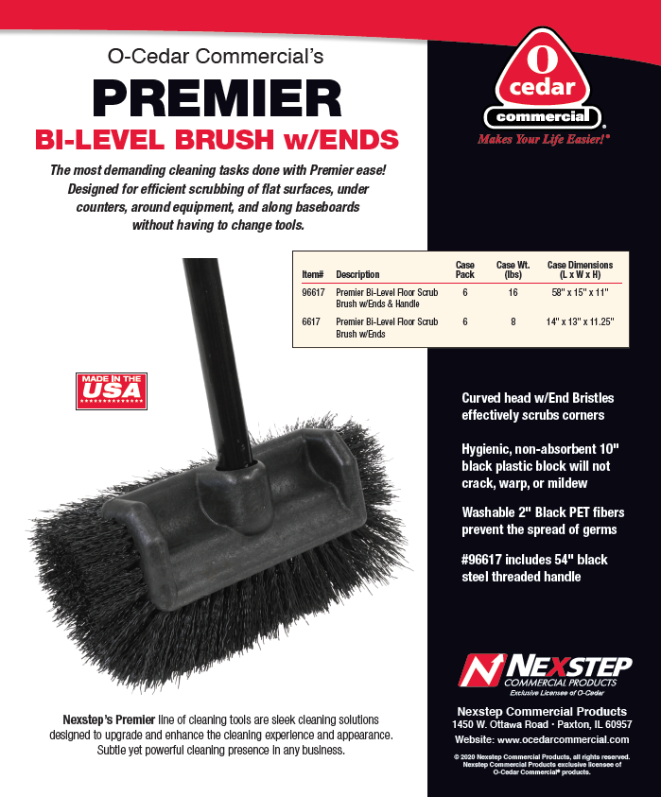
PREMIER
Bi-Level Floor Scrub Brush w/Ends
NEW
The most demanding cleaning tasks
done with Premier ease!
Designed for efficient scrubbing of flat surfaces, under
counters, around equipment, and along baseboards without having to change tools.
  #96617: Premier Bi-Level Floor Scrub Brush w/Ends & Handle
  #6617: Premier Bi-Level Floor Scrub w/Ends
Available
SOON

Slide 13
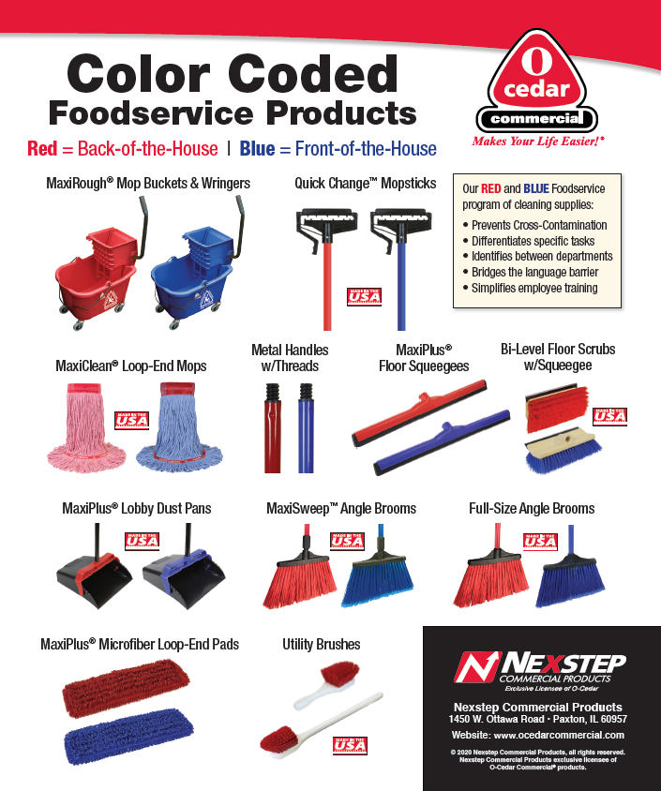
COLOR CODED
Foodservice Products
RED Back-of-the-House
BLUE Front-of-the-House
Available NOW

Slide 14
NEW Items
Focus on COVID-19

Slide 15
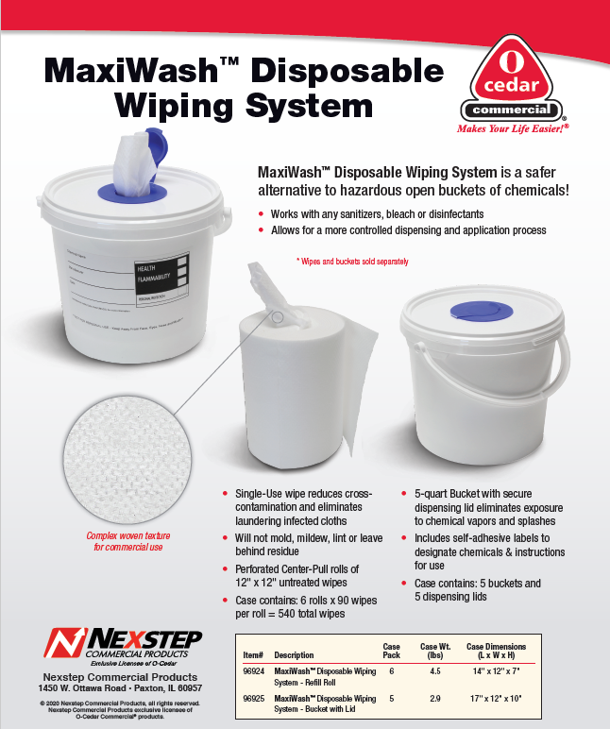
MaxiWash™
Disposable Wiping System
NEW
Safer alternative to hazardous open buckets of chemicals!
Add your choice of cleaning/disinfecting solution
Can be used with bleach or peroxide based product
Polypropylene material is Quat Safe
Will not mold, mildew, lint, or leave behind residue
#96924: MaxiWash™ Disposable Wiping System - Refill Roll
#96925: MaxiWash™ Disposable Wiping System
Bucket with Lid
Available NOW

Slide 16
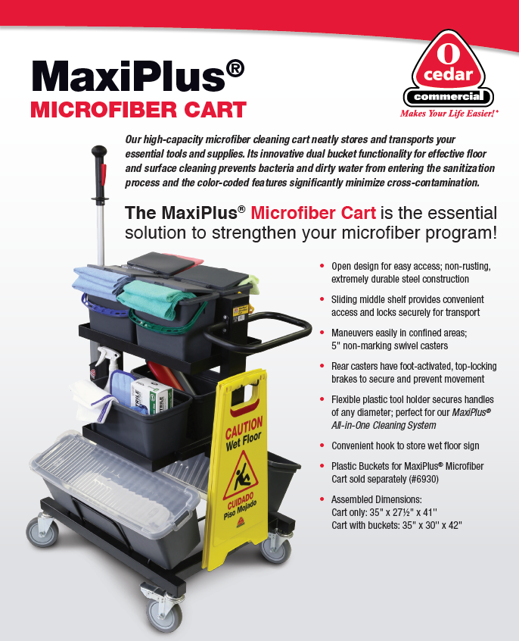
MaxiPlus® Microfiber Cart
NEW
The essential solution to strengthen your microfiber program!
Innovative dual bucket functionality for effective floor and surface cleaning prevents bacteria and dirty water from entering the sanitation process.
Color-coded features significantly
minimize cross-contamination.
#96930: MaxiPlus® Microfiber Cart
  Perfect for keeping clean and dirty microfiber separated
  #6930: Plastic Buckets for MaxiPlus® Microfiber Cart
  Plastic Buckets for
  MaxiPlus® Microfiber Cart sold separately
Available SOON

Slide 17

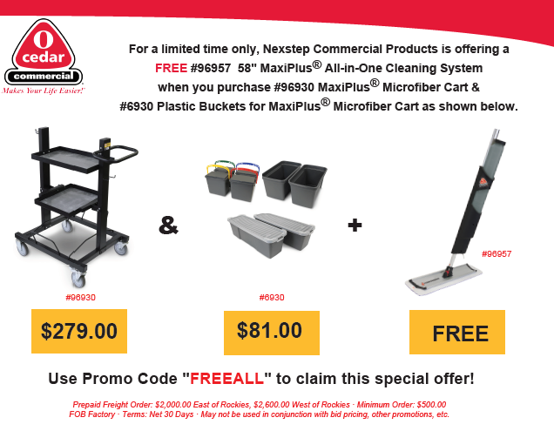
MaxiPlus®
Microfiber Cart
INTRODUCTORY
PROMOTION
COMING SOON

Slide 18
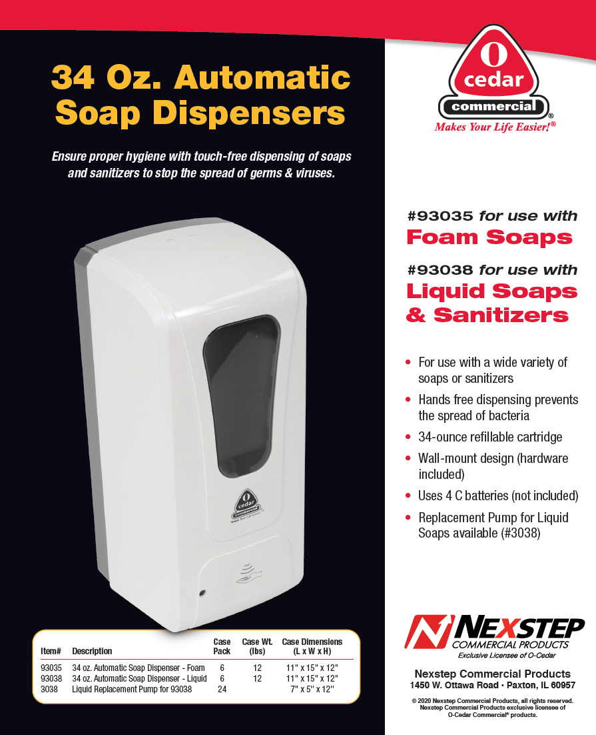
Automatic Soap Dispensers
NEW
Ensure proper hygiene with touch-free dispensing
of soaps and sanitizers to stop the spread of
germs & viruses!
#93035: 34 oz Automatic Soap Dispenser – Foam
  #93038: 34 oz Automatic Soap Dispenser – Liquid
    Dispense a wide variety of soap or sanitizer
  #3038: Liquid Replacement Pump for 93038
Available SOON

Slide 19

TPE Stretch Polymer Gloves
NEW
Engineered Resin
Economical & Readily-Available
Replacement to Vinyl
#9701 - Medium
  #9702 - Large
  #9703 – X-Large
Available JANUARY

Slide 20
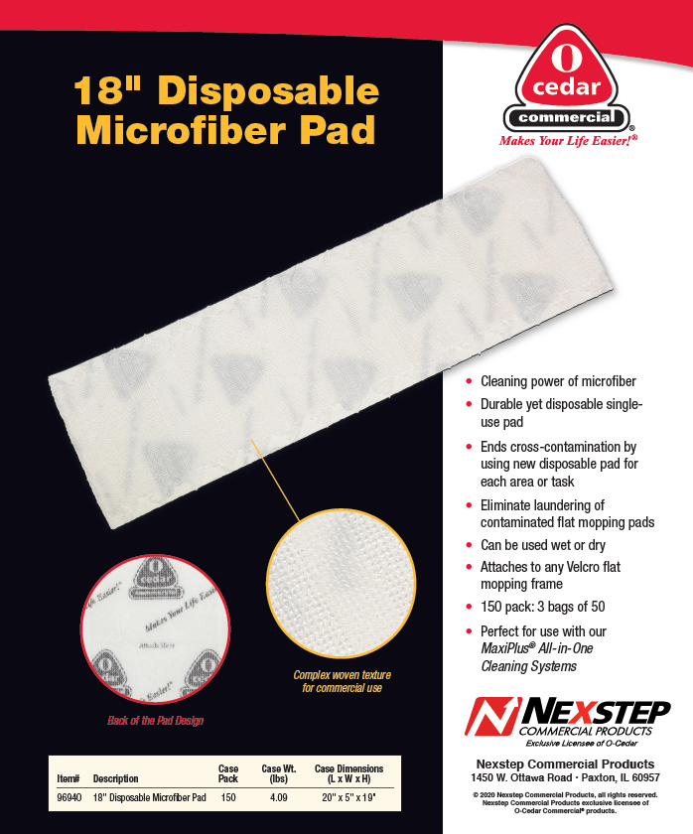
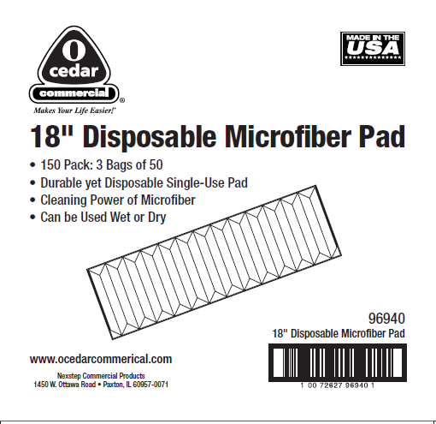
18” Disposable Microfiber Pad
NEW
#96940: 18" Disposable Microfiber Pad
Cash n’ Carry Packaging
Printed Case Design
Available SOON

Slide 21
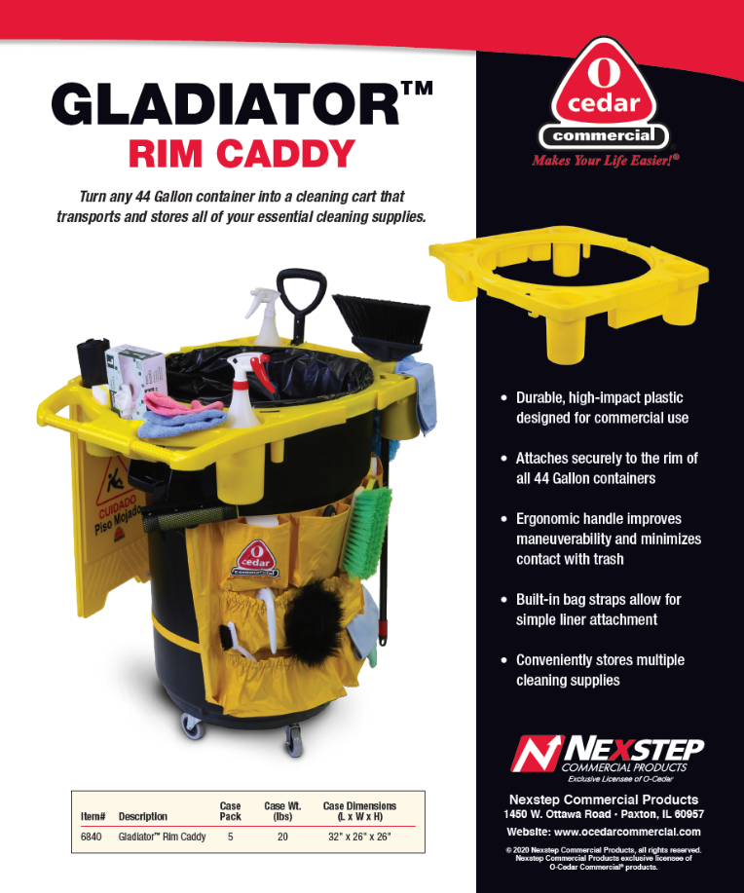
Gladiator™
Rim Caddy
NEW
Turn any 44 Gallon container into a cleaning cart
That transports and stores all of your
essential cleaning supplies!
#6840: Gladiator™ Rim Caddy
  snaps securely onto the rim of
  all 44 gallon containers
Available SOON

Slide 22


Additional resources available
Product Videos O-Cedar Commercial dedicated YouTube Channel
Website Interactive, Image Gallery instant downloads
COVID-19 pages
Electronic Catalog
Nationwide Sales Support
In-Person Training for Inside Sales Consultants
Zoom Video Presentations

Slide 23
Nexstep Commercial Products
(Exclusive Licensee of O-Cedar):
Is dedicated to providing our customers with innovative, top quality products
Offers very competitive prices, while still providing a leading brand name,
O-Cedar, that your customers know and trust
Primary objective to make cleaning quicker and easier
for today’s Operators & End Users
Thank You
for your time

