Slide 1

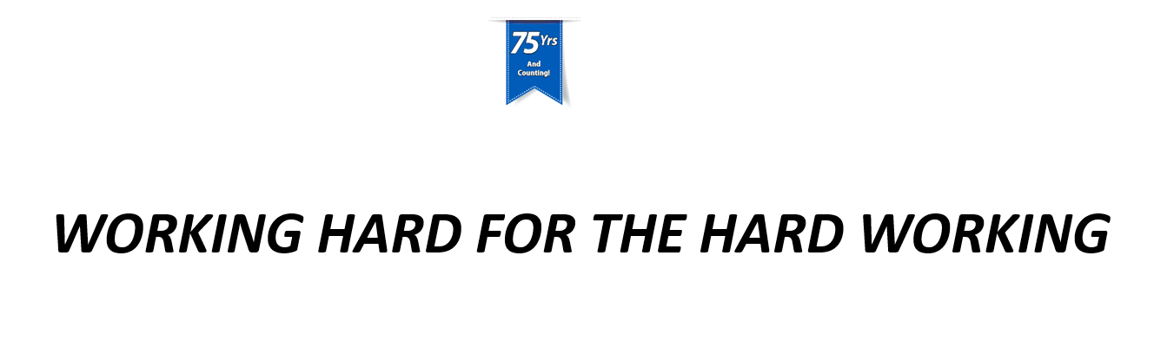

Slide 2
SWOT Analysis
Strengths/Opportunities
Unique Technology
Resources
Weaknesses/Threats
Underperforming Products
Brand Awareness

Slide 3
Strengths
PVC Foam
Tuff-Spun
Comfort-King
Hybrid Foam/Laminated
Wear-Bond Tuff-Spun
Wear-Bond Comfort-King
Laminated
Industrial Deck Plate
Workers-Delight Deck Plate

Slide 4
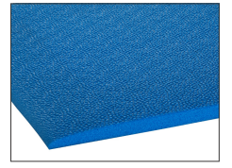
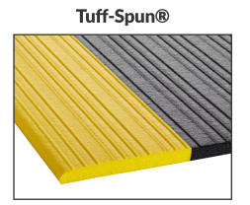

PVC Foam
Comfort-King
Tuff-Spun
Upgrade
Economic Foam
Sold to customers tight on budget or don’t mind replacing mats often.
Top mover in the industrial division.
Premier Zedlan foam
Has ~30% more density (raw material) vs. traditional market sponge.
Antimicrobial additives - great for labs and healthcare industry.

Slide 5
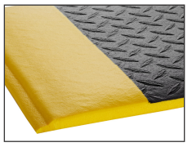
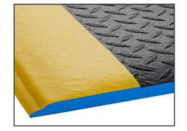
Hybrid Laminated Foam
Wear-Bond Tuff-Spun
Wear-Bond Comfort-King
Upgrade
Economic Foam with injected PVC.
Sold to customers who need something sturdier than the cheap foam, but still has the soft top surface.
Great product to position vs. traditional deck plate material.
Premier Zedlan foam with injected PVC.
Has ~30% more density (raw material) vs. traditional market sponge.
Antimicrobial additives - great for labs and healthcare industry.

Slide 6
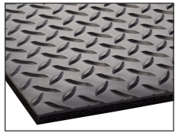
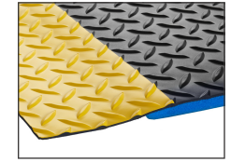
Laminated
Industrial Deck Plate
Workers-Delight Deck Plate
Upgrade
Economic foam with PVC laminated to the top surface.
Customized up to 12’ wide.
Sold to customers in heavy-duty areas such as automotive facilities and general manufacturing plants.
2nd best seller for the industrial division
Premier Zedlan foam with laminated PVC.
Customized up to 12’ wide.
Has ~30% more density (raw material) vs. traditional market sponge.
Antimicrobial additives - great for labs and healthcare industry.

Slide 7





Competition vs/ Zedlan
Upgrade

Slide 8
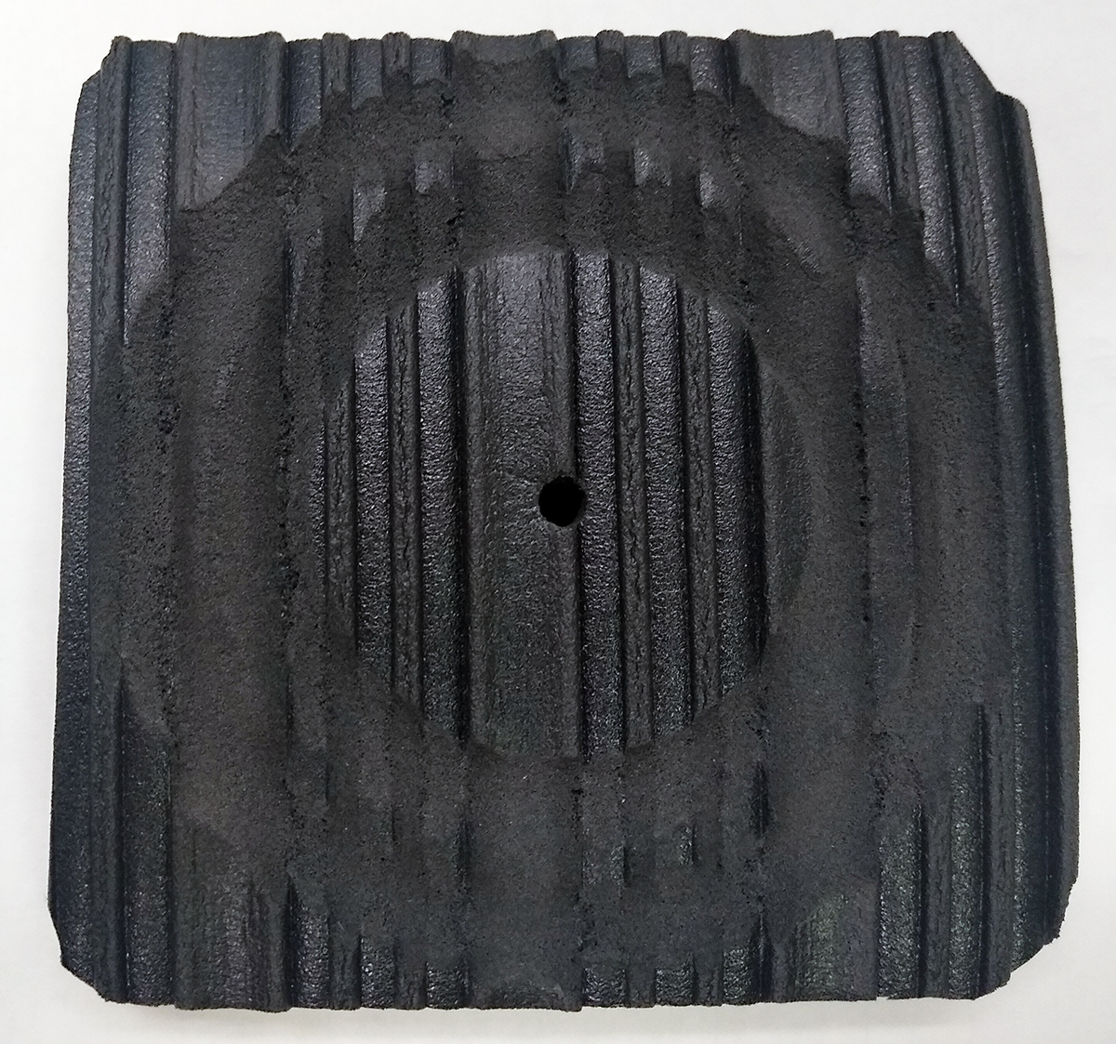
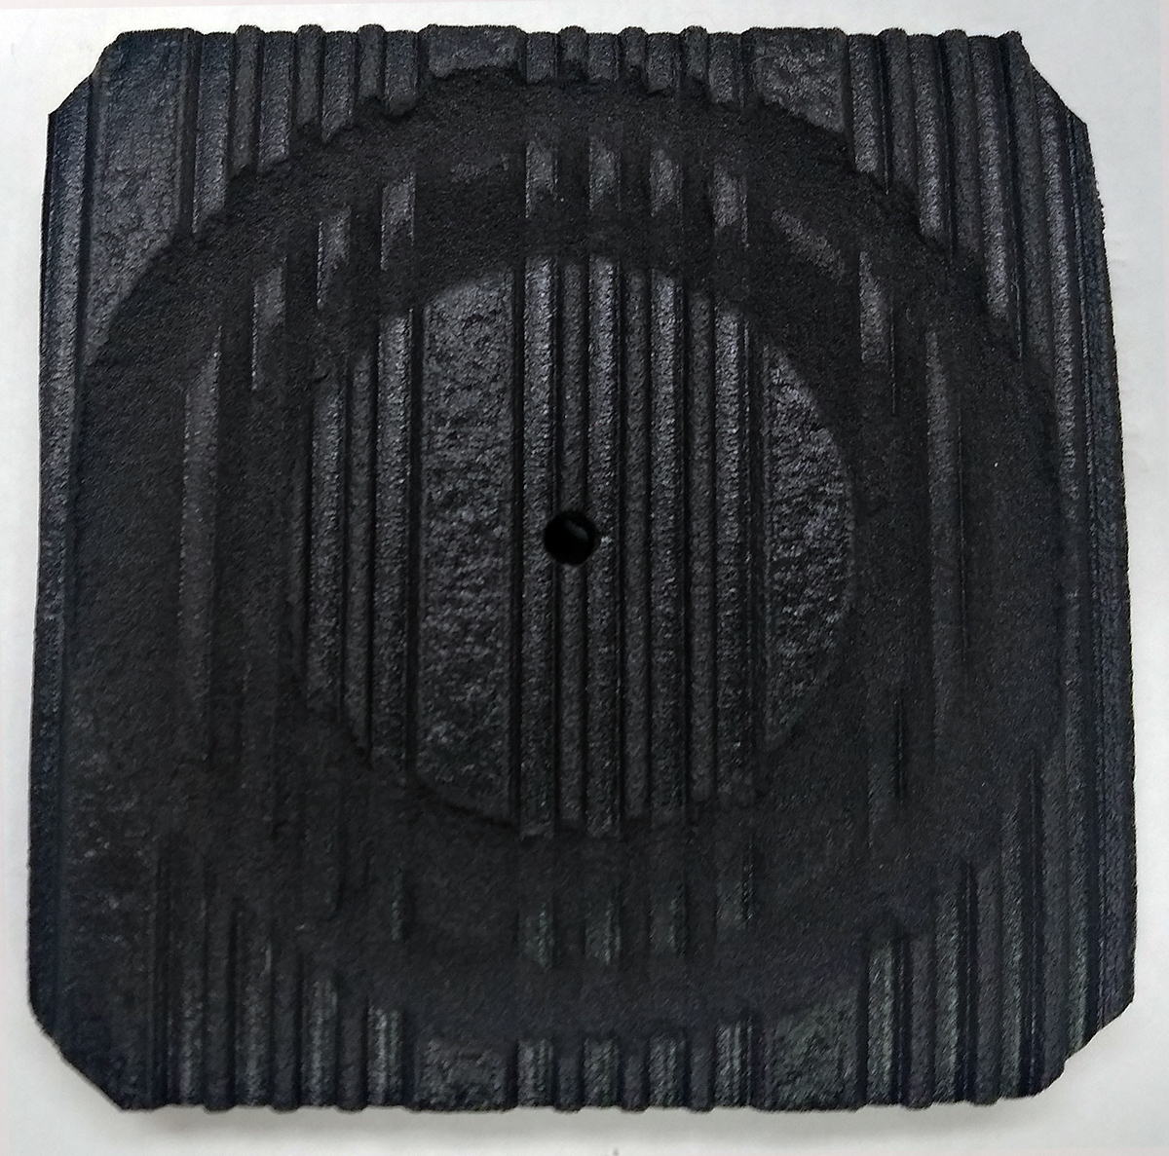
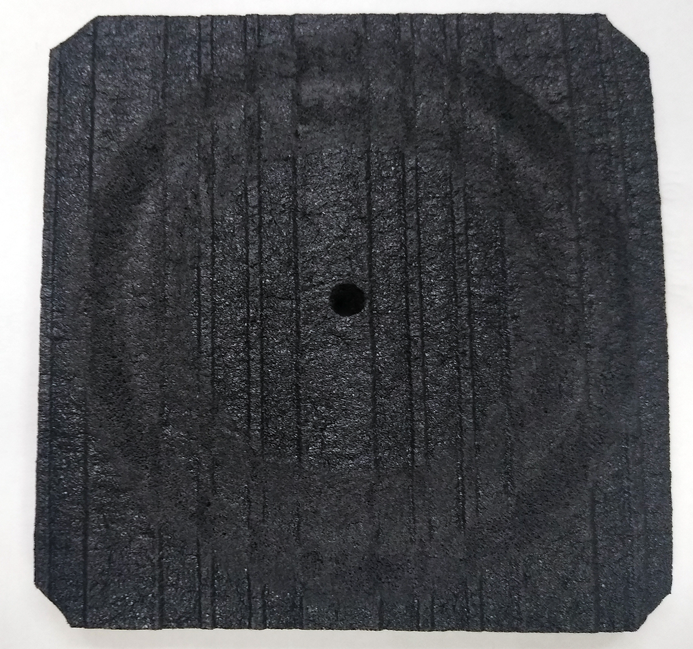
Tabor Abrasion Testing
Notrax
Wearwell
Crown Matting

Slide 9
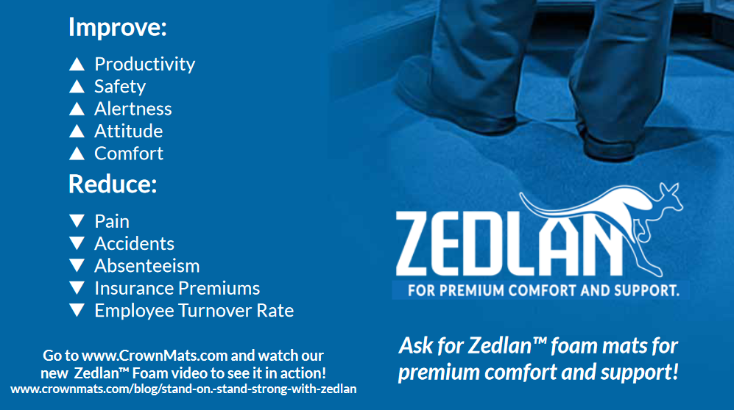
Why Matting?

Slide 10
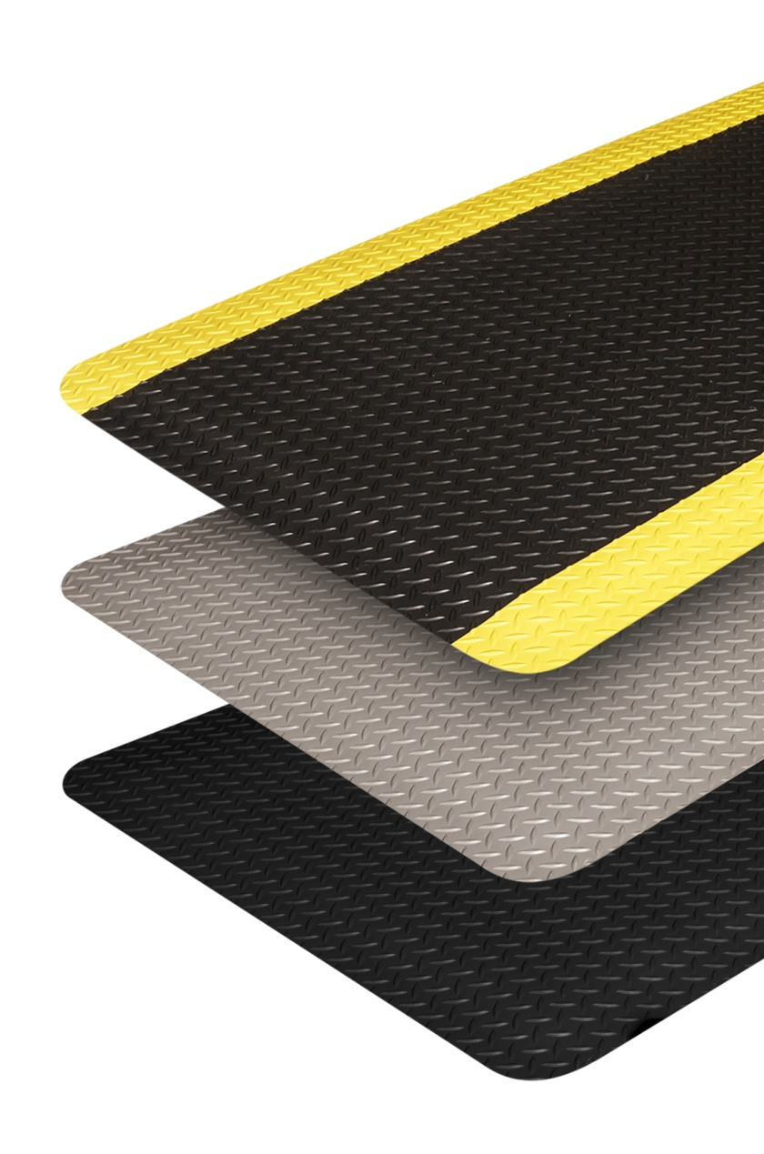
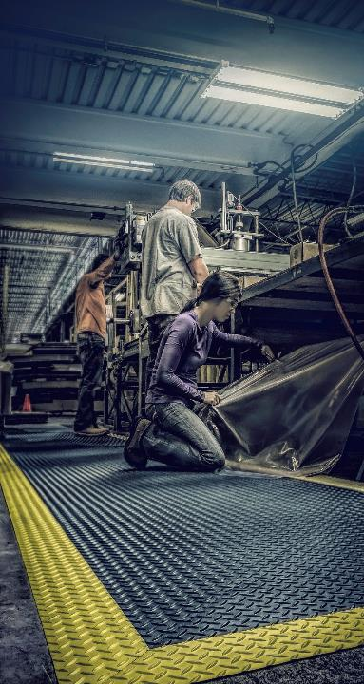
Dry Area Matting Applications
Finishing stations
Assembly stations
Workstations
Tool storage
Cart traffic areas
Pick & pack stations
Notes:
Anyplace a mat is needed, we can offer a solution.

Slide 11
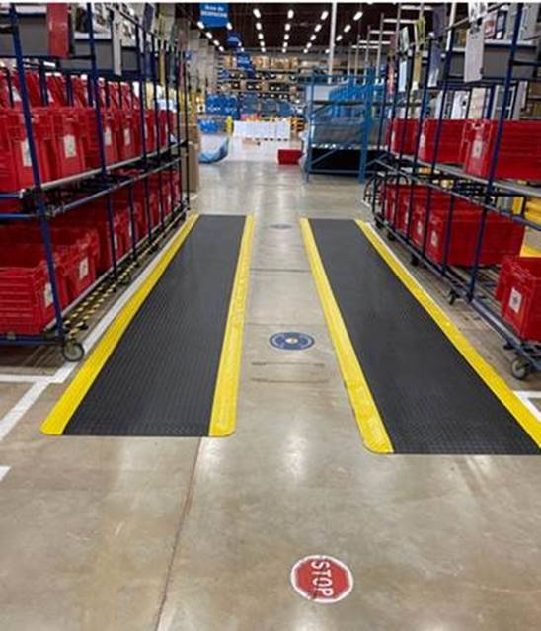
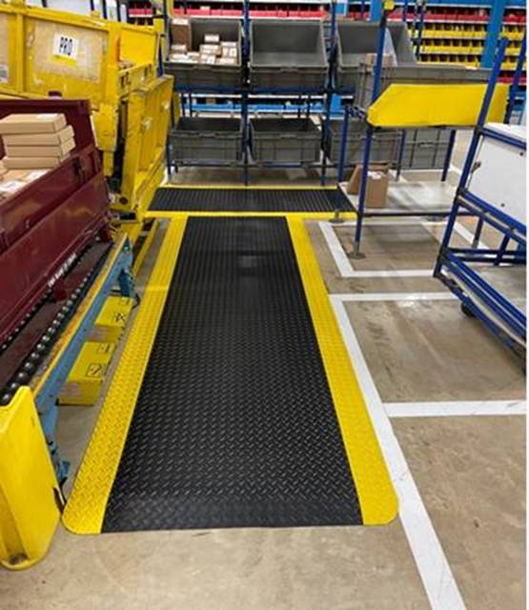
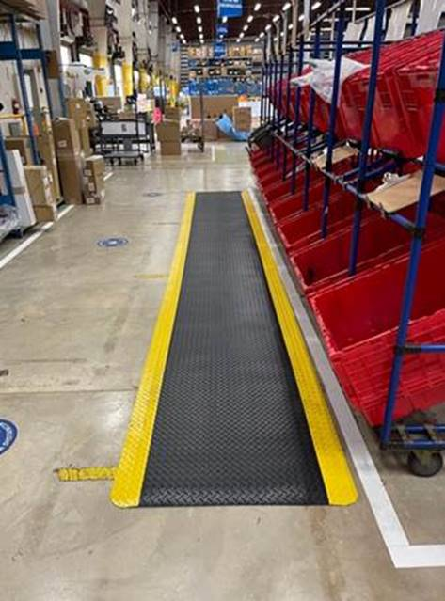
Workers Delight Deck Plate – Pictures

Slide 12
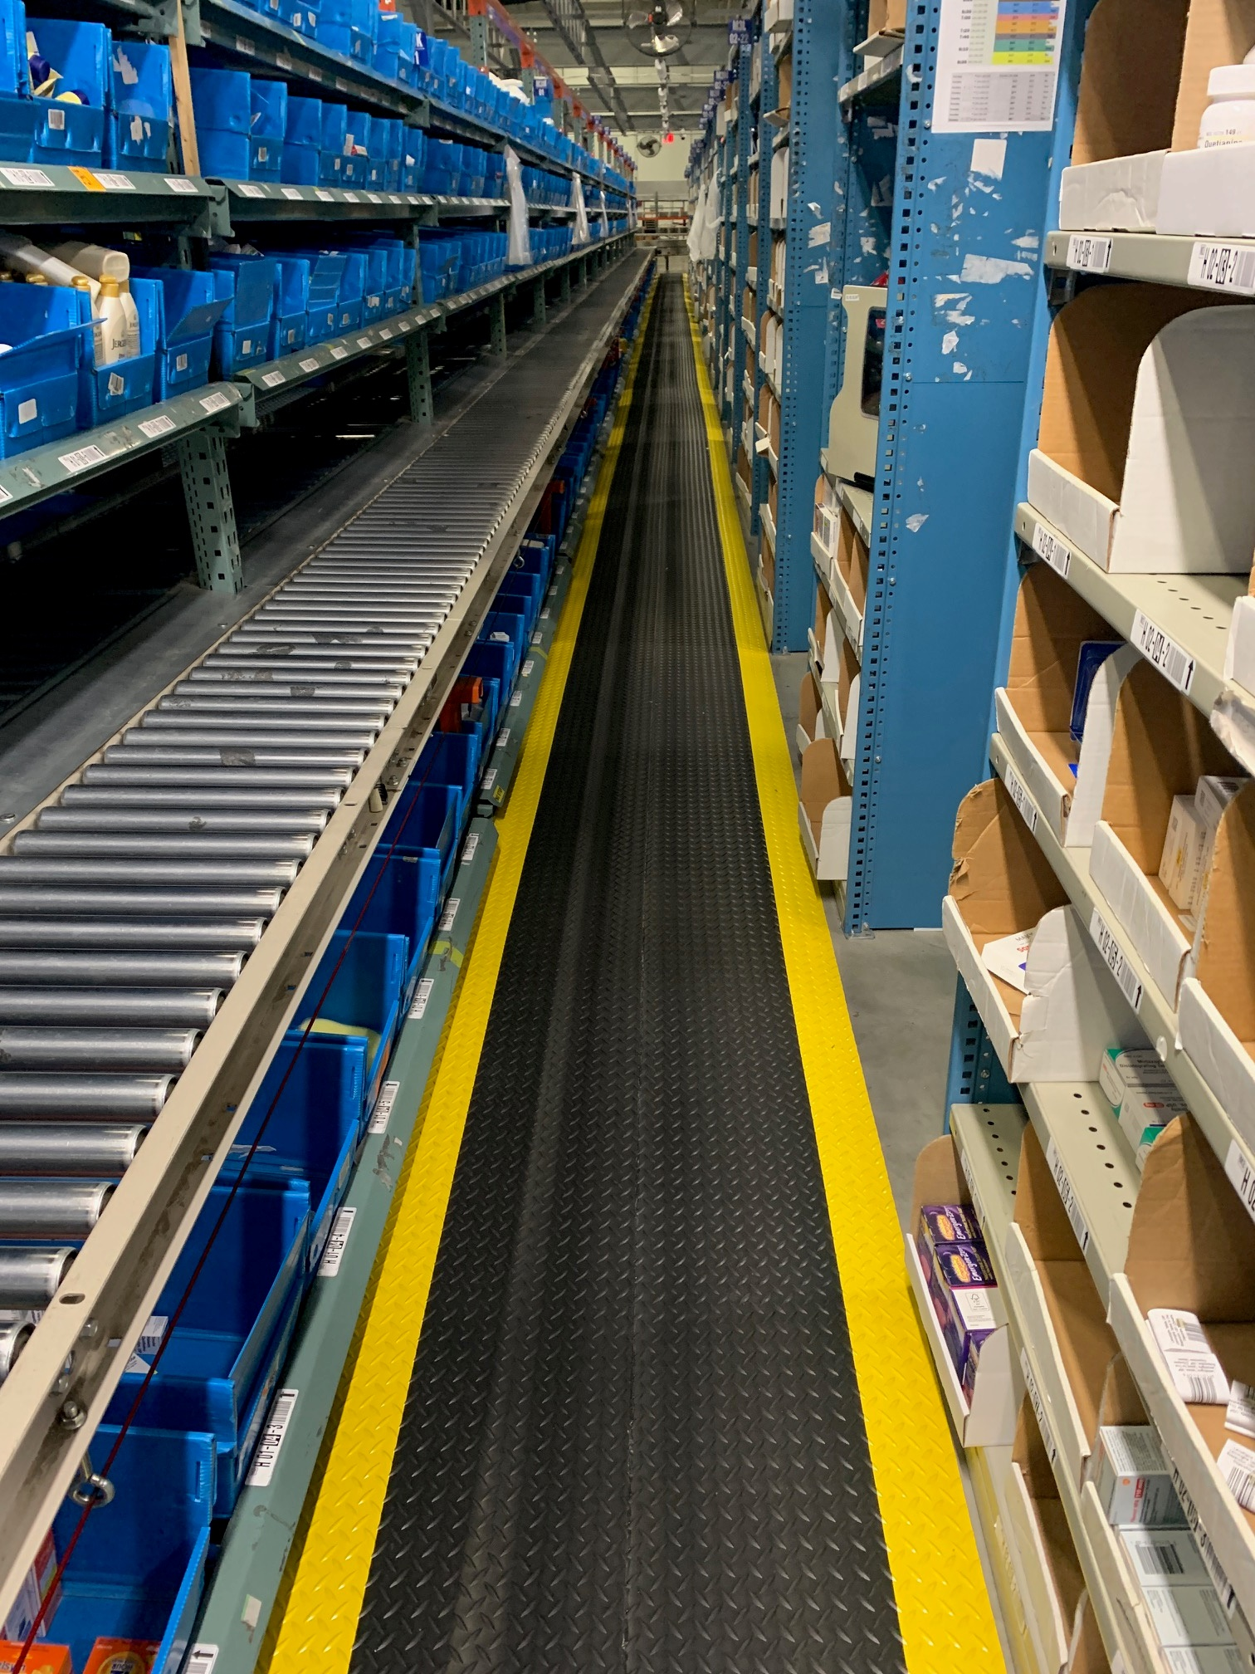
Workers Delight – Seamed Product Picture

Slide 13
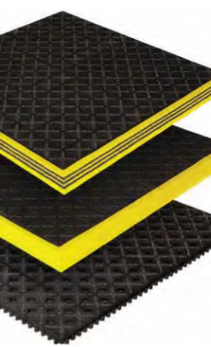

Wet Area Matting Applications
Power Transmission
Auto Manufacturers
Food Processing
Machine Shops
Washing Areas
Industrial Workstations
Notes:
Size and thicknesses

Slide 14
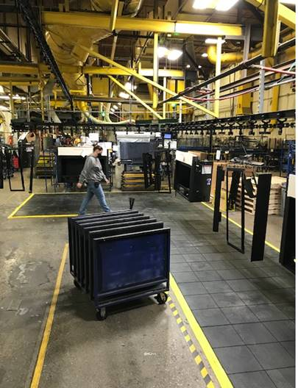
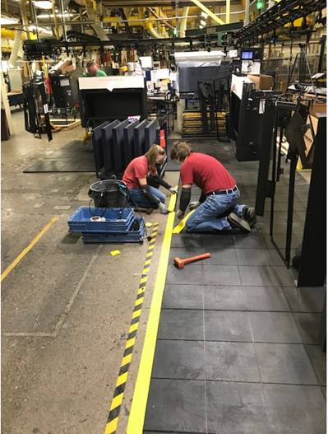
Safety Step Solid Top - Pictures

Slide 15
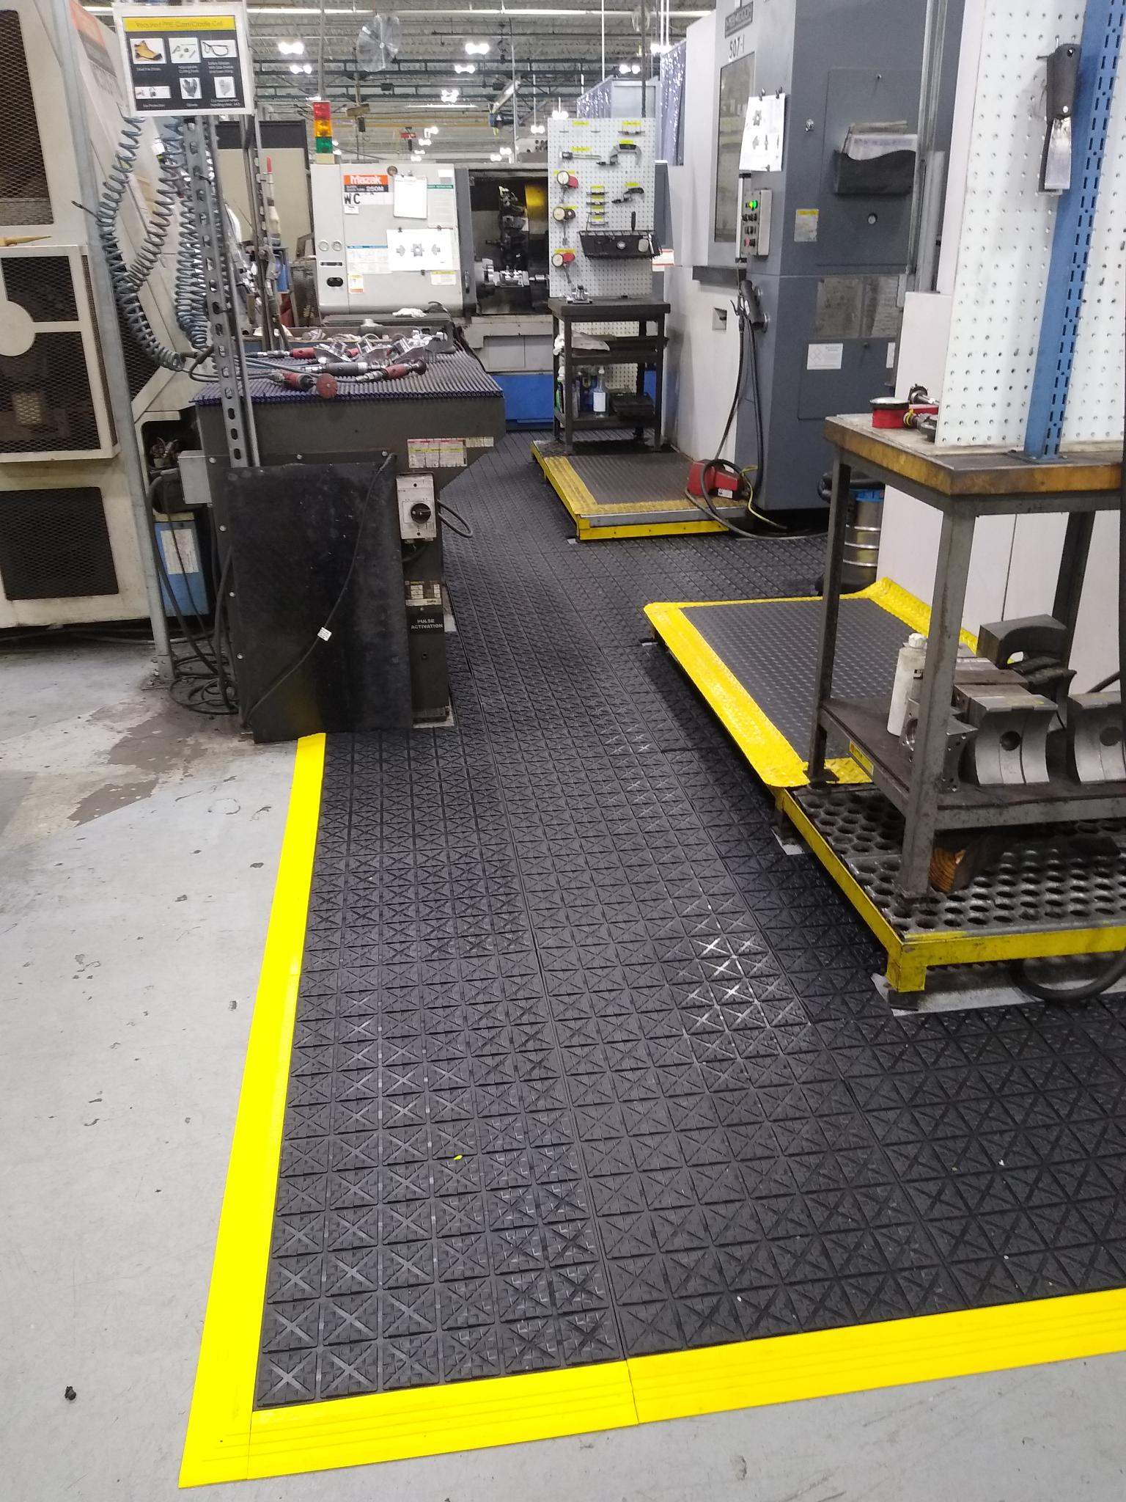
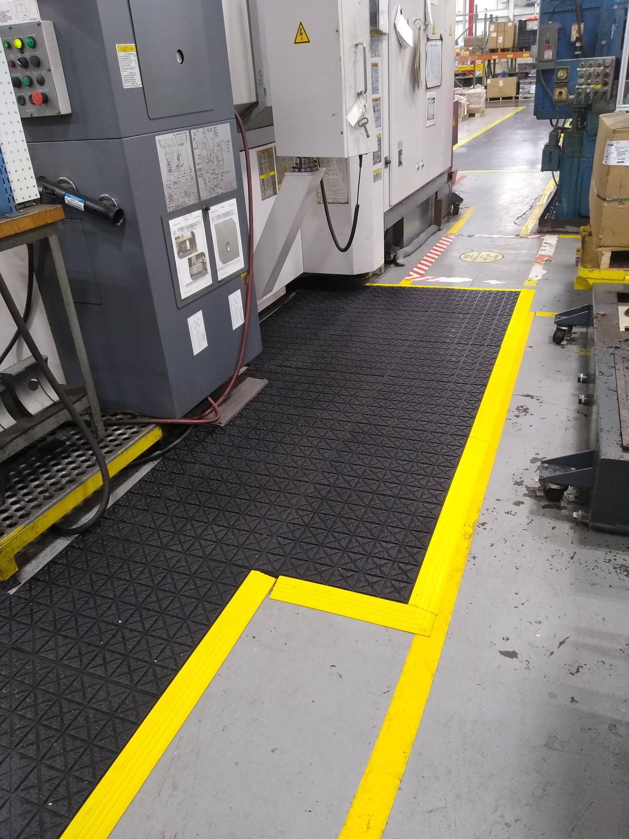
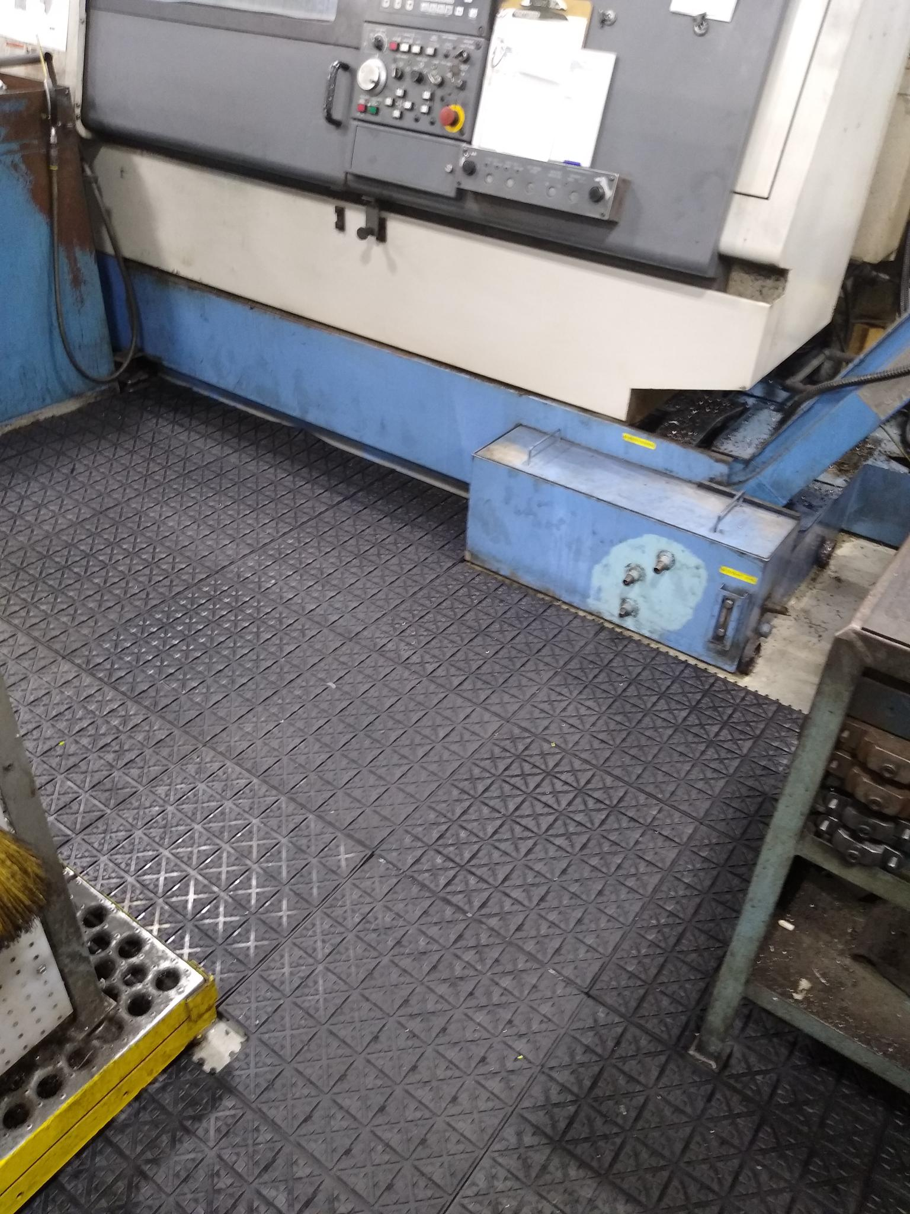
Ergo Extreme - Pictures

Slide 16
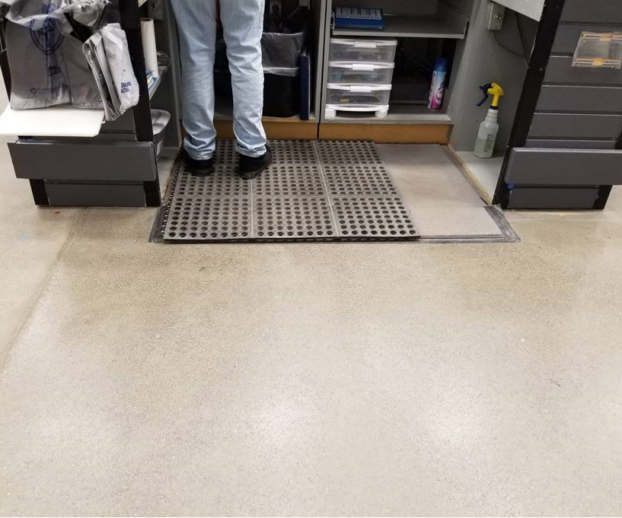
What to look for when selling
Bad matting or placements.
Do mats have proper edging?
Worn out mats.
Areas of high needs – employees standing, airports, service desks, labs, etc.

Slide 17
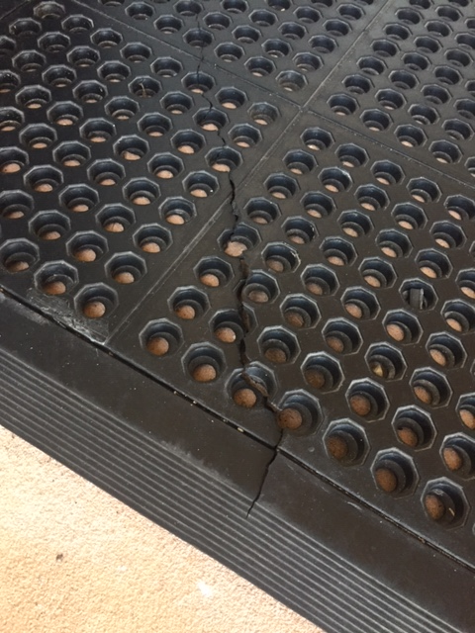
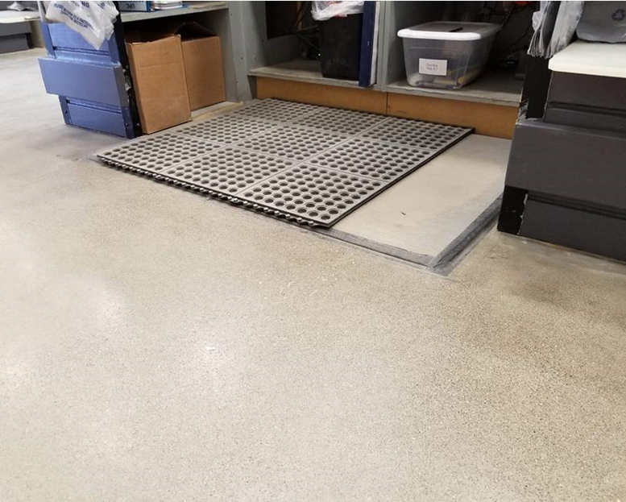

Opportunities

Slide 18
Questions to consider
Choosing the right mat for the application.
Where will the mat be used?
What elements are present (environmental, chemical, etc.)?
What is the traffic pattern?
What is the top concern for the customer?
  (safety, floor protection, anti-fatigue, aesthetics)
Which is the higher priority: quality/performance or cost?

Slide 19
Selling the Matting Solution
Going beyond purchasing or sales
  Facilities & Operations Managers
  Safety Managers (EHS)
  Human Resources
  Upper Management
  Building Service Contractors

Slide 20

The Solutions
The right matting can help end-users:
1. Improve employee productivity
2. Reduce lost time
3. Reduce injuries and incidents
4. Upgrade facility aesthetics
5. Save money

Slide 21
SWOT Recap
Strengths/Opportunities
  Foam and laminated products
  Zedlan Foam: Comfort King and Workers Delight
  Service time (CSR, sales team, field support)
  No min orders
  Large product mix with minimal market gaps
    Manufacturing, healthcare, food service, aerospace, material handling, office, retail, OEM.
Weaknesses/Threats
  No cleanroom ISO certifications
  Website and marketing has traditionally been more commercial matting driven.
  Best kept secret for many years
    M&A: Hog Heaven & Waterhog
    Wearwell: Ergodeck
    Apache: cheap products

Slide 22

Questions

