Slide 1
Mats are NOT SEASONAL
Selling the Solution…One Step at a Time

Slide 2
AGENDA
Why Buy Crown Mats?
Company Overview
We offer solutions for Entrance Areas
We offer solutions for Ergonomic Areas
Be The Savings Hero – 5 Sessions
Marketing Support/ Inside Sales

Slide 3
Why Choose Crown Mats
We make and manufacture custom floor mats for commercial entrances and industrial work environments. We offer our customers a wide selection of colors, textures, thicknesses, sizes, borders, and backing options to select the best mat for their entrance or work environment.
Our product selection offering:
Outdoor mats
Indoor mats
Logo/image mats
Ergonomic Safety/anti-fatigue mats
Food Service Mats

Slide 4
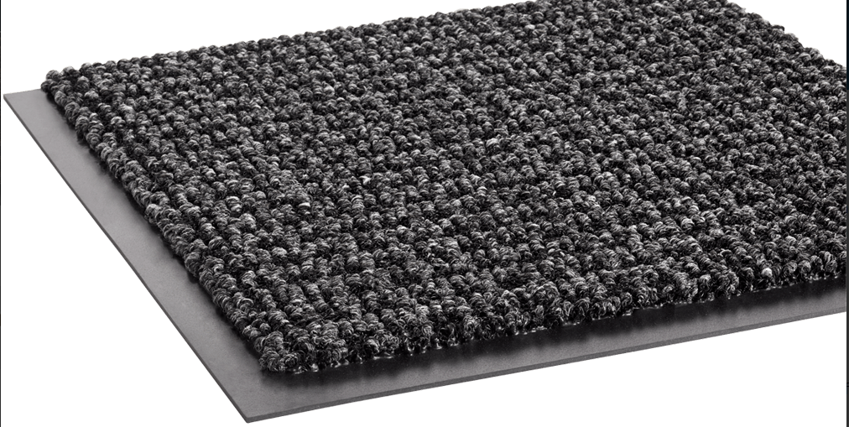
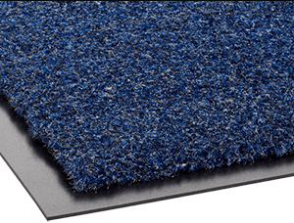
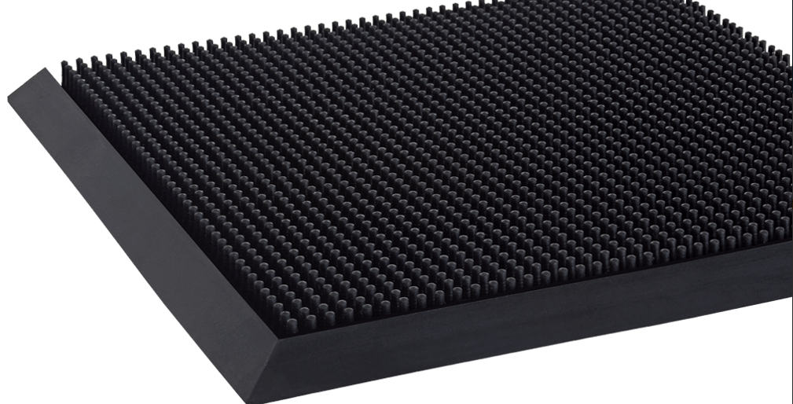
Where do mats go?

Slide 5
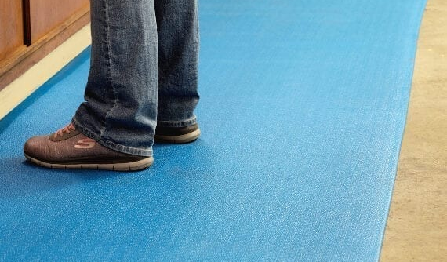
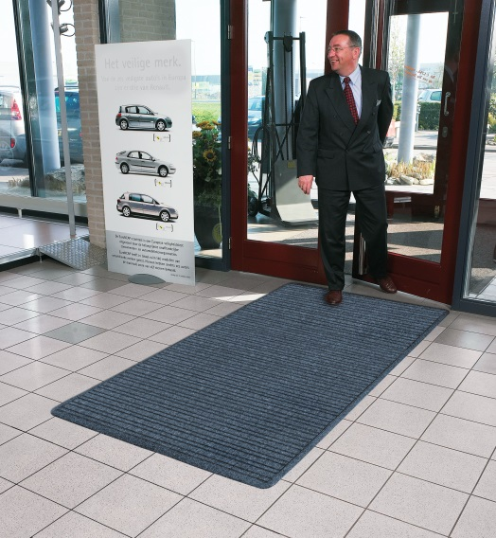
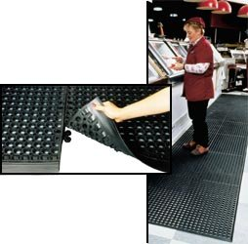
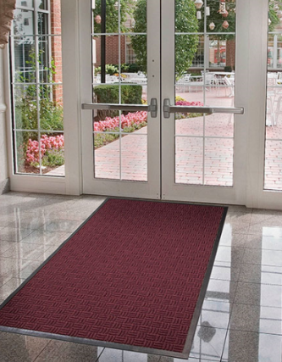
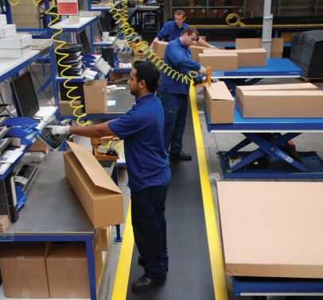
EVERYWHERE

Slide 6
CROWN HERITAGE
1961 Relocated to present facility in Fremont, Ohio
1963 Invented first vinyl backed carpet mat and vinyl foam anti-fatigue mat
1994 Expanded carpet operations to Canada
Mat Tech – Granby, Quebec
1999 Awarded patent for industry leading foam technology – Zedlan® Foam
2009 Named Ohio’s “Exporter of the Year” for small and medium-sized businesses
2012 Welcomes new ownership – Desco Capital
2019 Awarded NFSI certification for Thermo-Grip™ backing technology

Slide 7
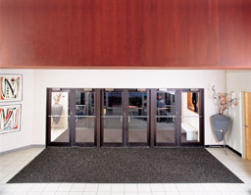
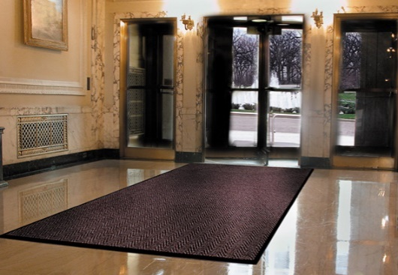
IMAGE OR GRAPHIC
Benefits of Floor Matting:
90% of all dust & dirt is tracked into a facility from people walking through the front door
Tracked in dirt permanently scars wood floors and tile, and stains carpet
Soils that are not captured and retained can become airborne, effecting IAQ ( Indoor Air Quality )
Soils accumulate most frequently within the first 10-20 feet of an entrance

Slide 8
How to select Entrance Mats We recommend conducting an internal audit of the facility climate environment and foot traffic volume for visitors and employees.
Questions to ask:
1. What is your facility climate environment?
2. How many entrances does a facility have?
3. What is your daily expected foot traffic?
Light Traffic – Under 125 people
Medium Traffic – Up to 500 people
High Traffic – 1,500 People or more
Fact: 90% of all dust & dirt is tracked into a facility from people walking through the front door! Stop the spread of germs and allergens with entrance mats.

Slide 9
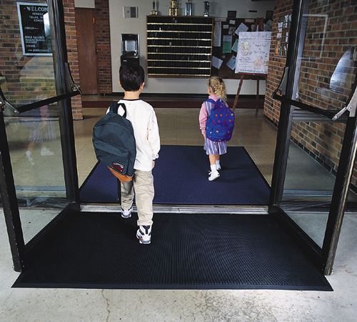
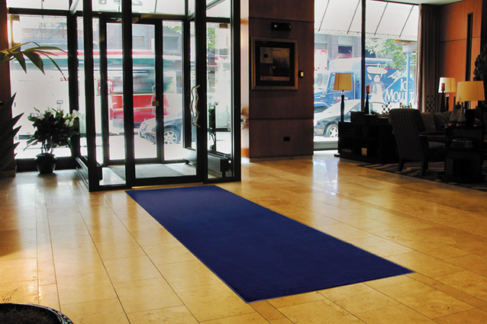
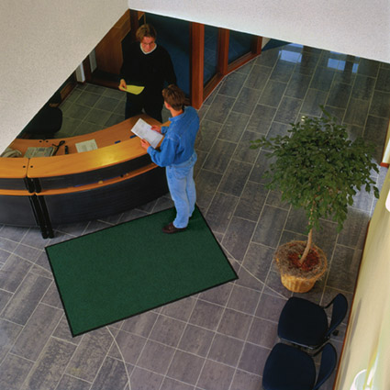
TYPES OF ENTRANCE MATTING
SCRAPER MAT: Designed with an abrasive top surface to assist with the removal of dirt and debris from the bottom of shoes. Best placed outdoors or in between Vistula doorways.
SCRAPER & WIPER MAT: Designed with an abrasive top surface that scrapes dirt and removes moisture from the bottom of shoes.
WIPER MAT: Designed to remove moisture and trap fine dirt tracked into buildings from shoes. Wiper Mats are a must in every building to keep floors safer and clean.

Slide 10
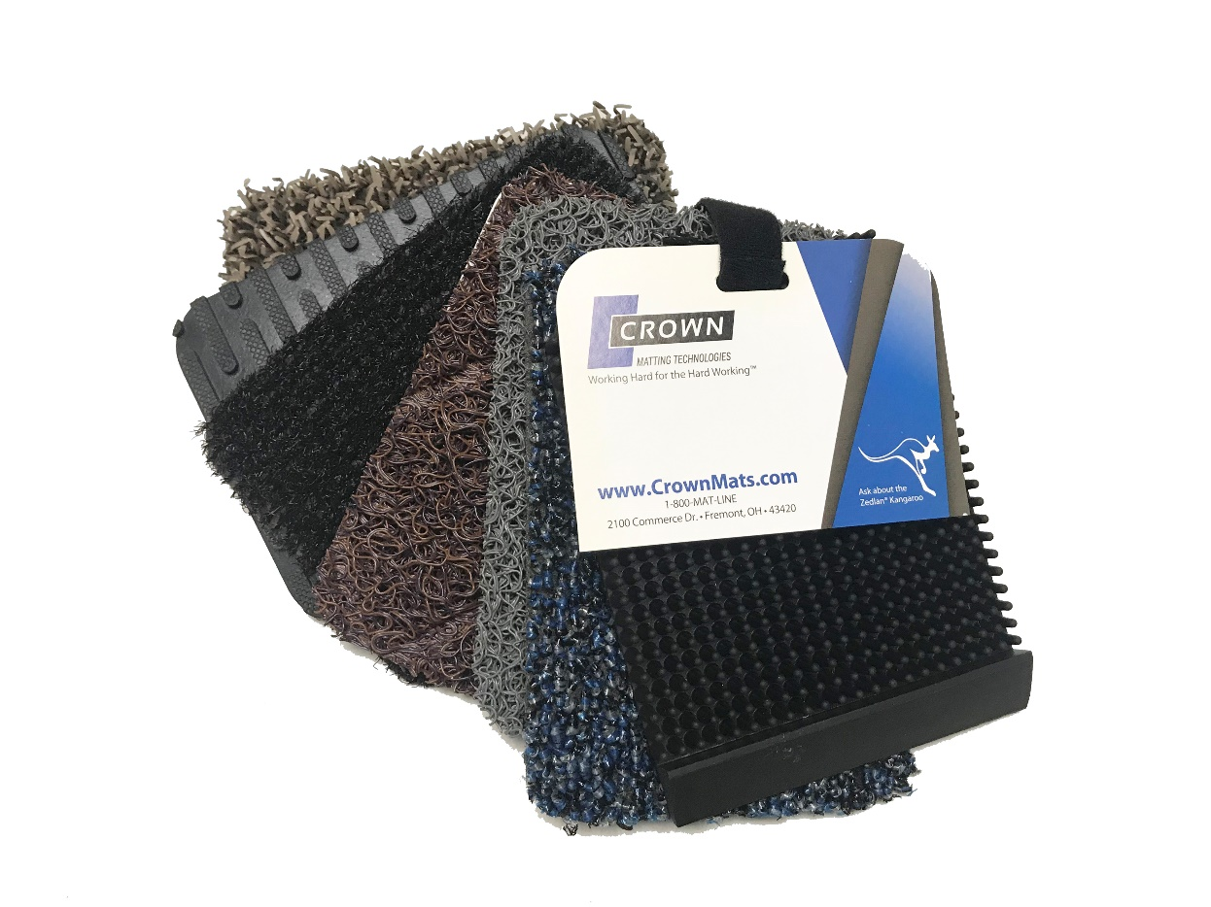
Outdoor Mats
Light Traffic – Under 125 people
Crown-Tred™ #145
Spaghetti Mat™ #130/131
Medium Traffic – Up to 500 people
Jasper #175
Mat-A-Dor™ #100
Diamond-Deluxe™ Duet #125/126
Heavy Traffic – Up to 1,500 people
Commercial Clean Machine® #110
Request an Outdoor sample chain set at sales@crownmats.com.

Slide 11
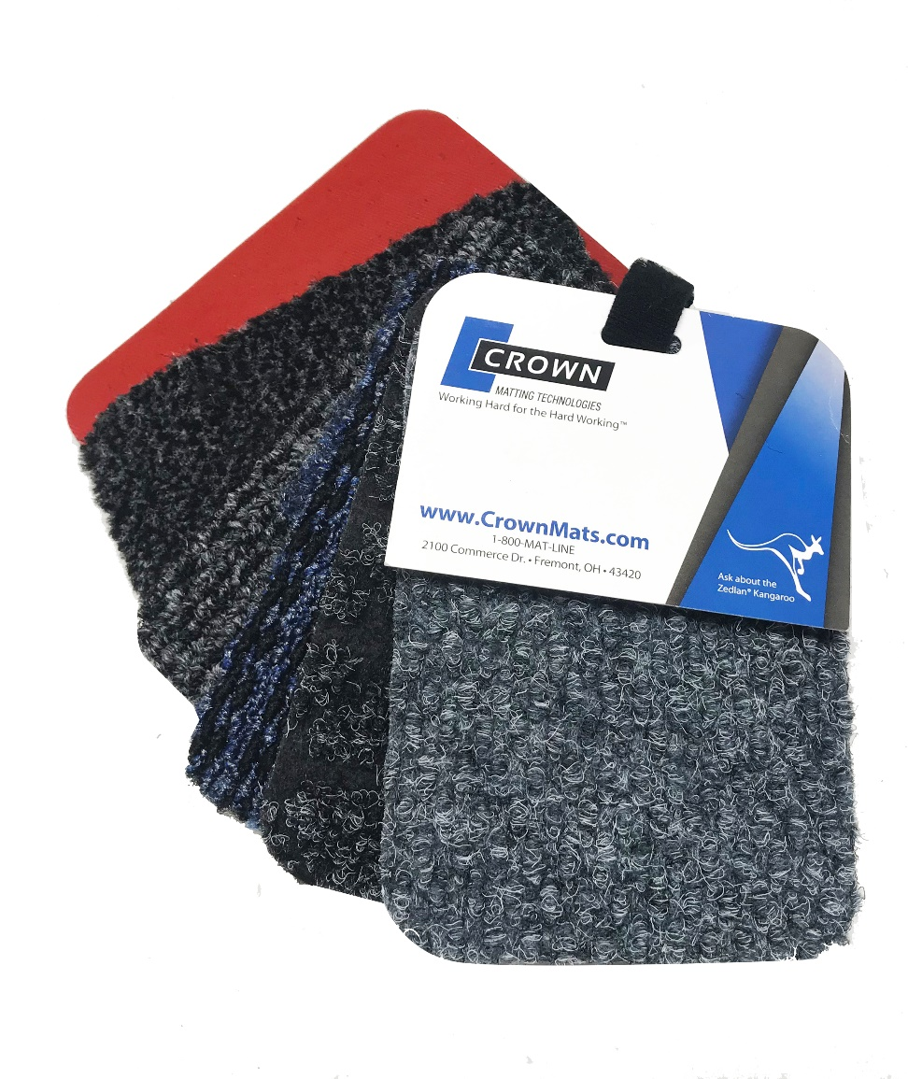
Indoor Mats NEW! ThermoGrip™ Backing
Medium Traffic – Up to 500 people
Oxford™ Elite #265
Oxford™ #360
Heavy Traffic – Up to 1,500 people
#228 Marathon™
#225 Tire-Track™
Oxford™ #360
Dust-Star™ #350
Benefits:
NFSI Certified
Product upgrade with NO change in price
Strongest backing, holds up in harsh weather conditions—crack resistant
Best option for high traffic areas
Made with BactiStop—Antimicrobial agent that prevents the development of germs and mold underneath your entrance mat
Request a ThermoGrip sample chain set at sales@crownmats.com.

Slide 12
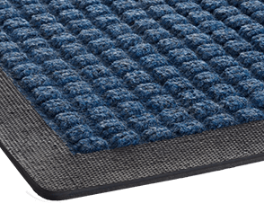
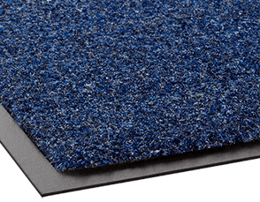
Most Common Indoor Mats
Super Soaker: SCRAPER/WIPER | MEDIUM TRAFFIC
Super-Soaker is our most popular wiper/scraper for demanding environments. Superior design traps dirt in the grooves of the mat and extends the life of your flooring investment. Fibers designed to retain water and reduces hazardous floor conditions. As a Performance Collection mat, this premium product will hold pounds of dirt and continue to wipe moisture from shoes.
Non-skid nib backing will effectively grip mat to the floor
Crush-proof waffle pattern will scrape shoes and hold dirt beneath shoe level while wiping moisture
Will scrape shoes and hold dirt beneath shoe level while wiping moisture
Rubber or fabric border available
Rely-On Olefin: WIPER | LIGHT TRAFFIC FEATURES
Rely-On Olefin is our economical wiper mat available in a wide array of colors to match most décors. As a wiper, Rely-On Olefin plays a major role in the retention of water and fine dust so fewer contaminants enter the building. It helps protect floors with vinyl backing moisture barriers. Affordable solution for small commercial locations.
Holds up to 1 gallon of water per square yard
The small profile fits under most doors
A wide selection of attractive colors that resist fading, staining, mold, and mildew
Holds up to 1 gallon of water per square yard
The small profile fits under most doors
A wide selection of attractive colors that resist fading, staining, mold, and mildew

Slide 13
Image Mats
Light Traffic – Up to 150 people
Flocked Mat #010
Embossed Anti-Fatigue Mat #050
Medium Traffic – Up to 500 people
Crown-Tred™ Printed #40
Super-Soaker™ Inlay
Jet-Print #30
Heavy Traffic – Up to 1,500 people
HD Jet-Print™ Vinyl Backing #035
Super Berber Inlay #065

Slide 14
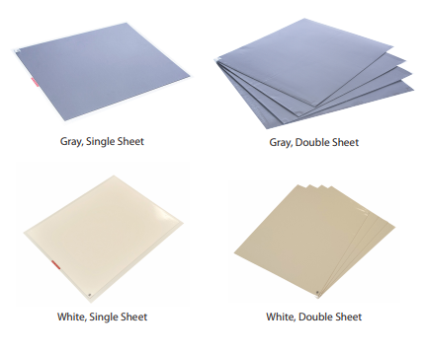
Walk-N-Clean
Two tray sizes available for your specific usage
31.5" x 25.5“
31.5" x 51“
60 shoe-cleaning sheets treated with an anti-microbial agent
Nontoxic refillable frame with a non-skid backing
Replacement pad size: 30" x 24“- case of 4
Contains 30% recycled materials
Provides a light-duty solution for dry areas. e.g.: Laboratory, White room, Medical office, and Printing facility.
*FDA approved for direct food contact applications.*

Slide 15
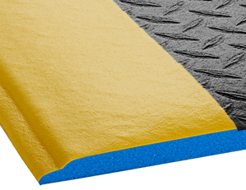
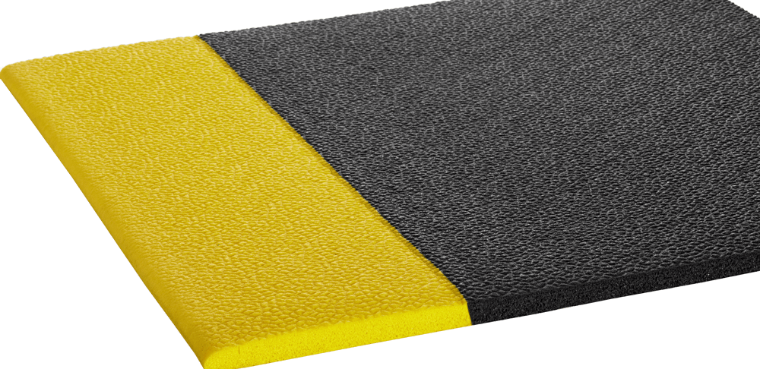
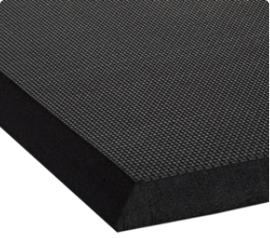
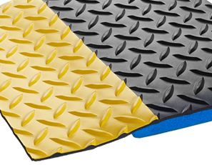
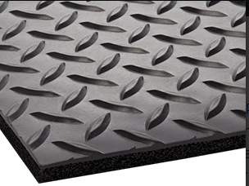
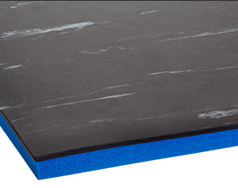
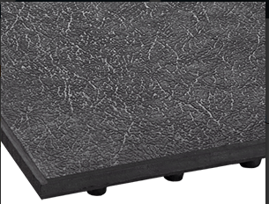
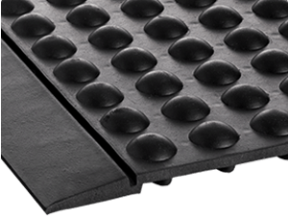
DRY – Ergonomic/ Anti-Fatigue Mats
Foam mats
Wear-Bond™ Comfort-King™ #560/#562
Tuff-Spun® #410 / #411
Para-Mount™ #649
Laminated mats
Workers-Delight™ Deck Plate #540/#550
Industrial Deck Plate #505
Workers-Delight Supreme #541
Rubber mats
Safety-Step™ - Solid #685
Yoga-Flex #695

Slide 16
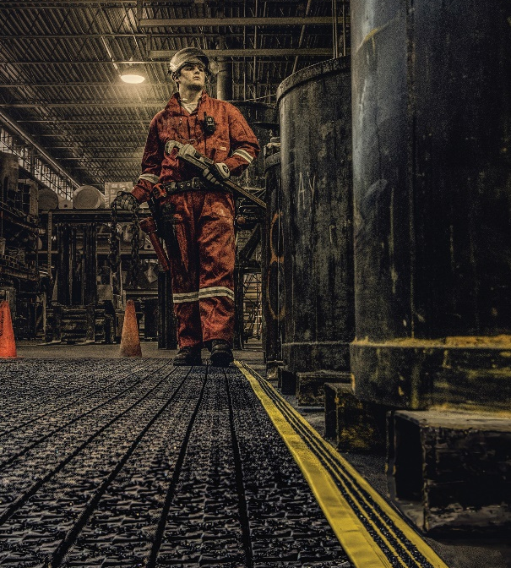
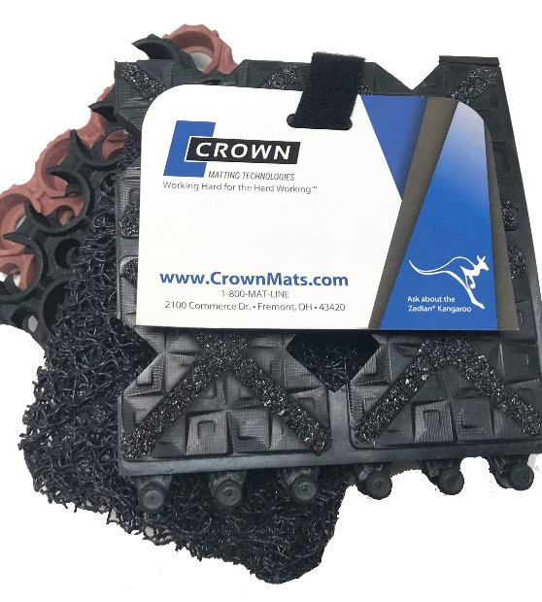
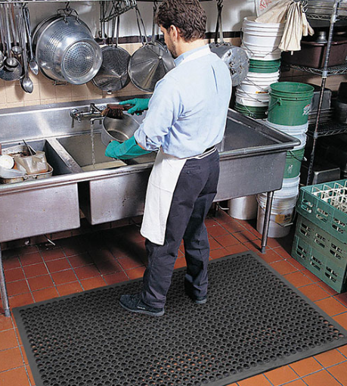
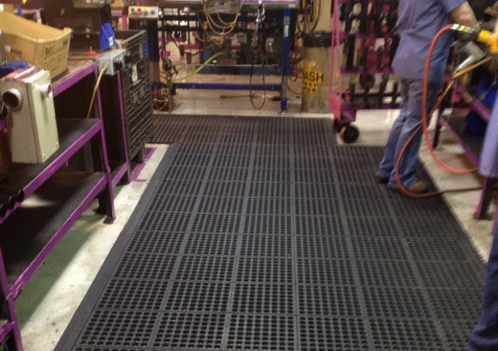
Wet -Anti-Fatigue Mats
Wet Mats- Classic
Safewalk-Light™
Safe-Flow Plus™
Wet Mats- Preferred
Safewalk™
Wet/ Oily Mats- Premium Mats
Ergo X-Treme™
Safety-Step™
Diamond-Deluxe™ with Grit-Safe™

Slide 17
Who needs mats? Everyone
Go Beyond Purchasing!
Sell to:
Facilities & Operations Managers
Safety Managers
Human Resources
Building Service Contractors

Slide 18
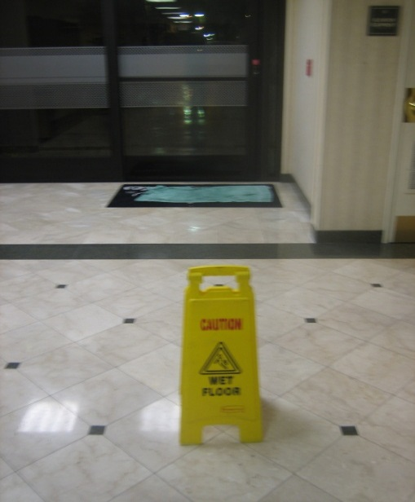
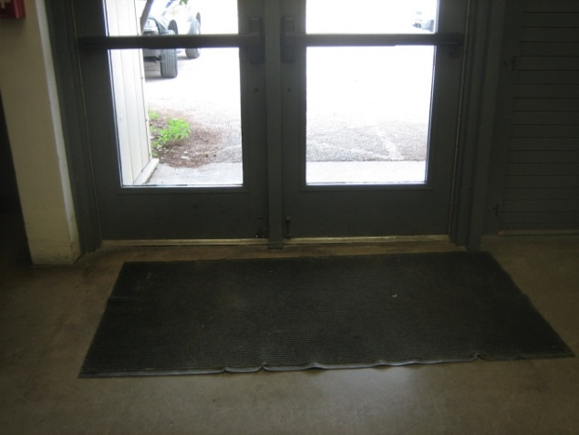
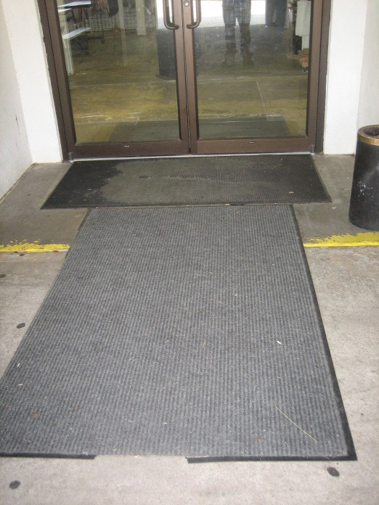
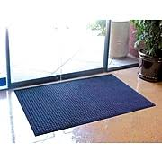
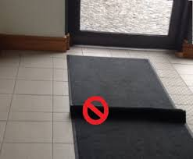
Worn out- edging falling off, carpet crushed down
Do a Facility Site Survey!
No mats at all
Not enough walk-off matting
Spot Trip hazards –
curling edges, rippling

Slide 19
Questions to Ask:
Is matting currently being used?
If so, where and what type?
Is the application a safety or maintenance issue?
Are there any liquids or debris falling onto the floor?
Do you notice worn spots or stains on carpets or flooring?

Slide 20
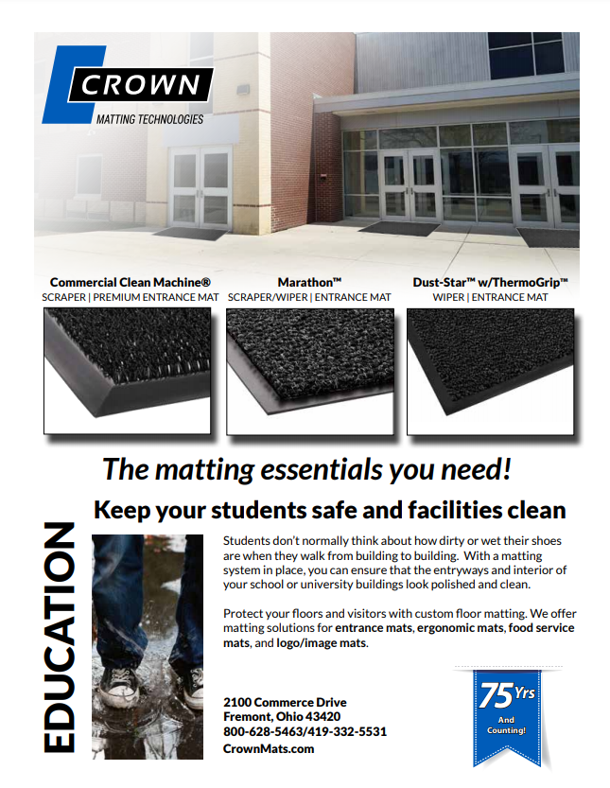
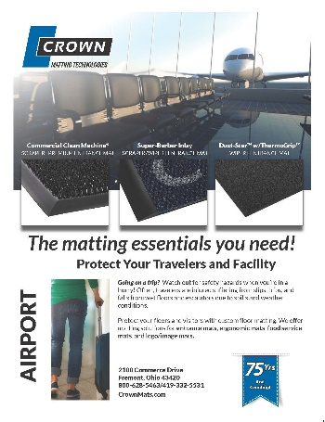
Digital Sales and Marketing Tools:
Go to www.CrownMats.com
Scroll to the footer Resource Tools
to download digital sales tools!

Slide 21
Any Questions?

