Slide 1
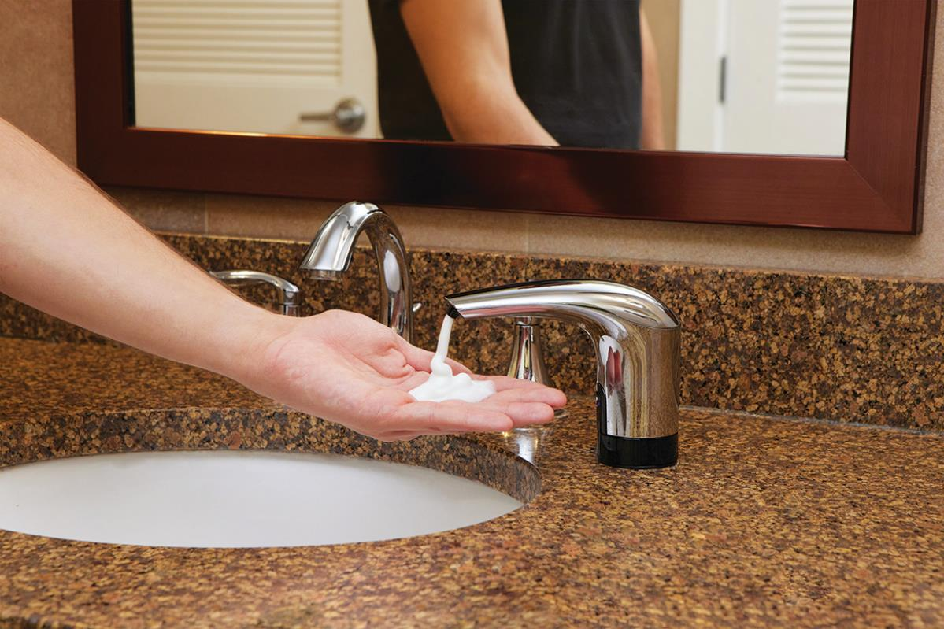

TOPFILL™ No Touch Counter Mount
SALES KICKOFF

Slide 2
Value Prop
Features
Selling Tools
Opportunities
    Pricing and Competitors
Agenda

Slide 3
Value Prop
Maximize labor efficiency and reduce soap costs while enhancing the health and prestige of a facility with TOPFILL.
Notes:
Value prop of the TOPFILL system: This is what you should be communicating to everyone you talk to about the dispenser.
It’s based on the four differentiators of the system: labor efficiencies, image enhancement, cost savings and safety / health.

Slide 4
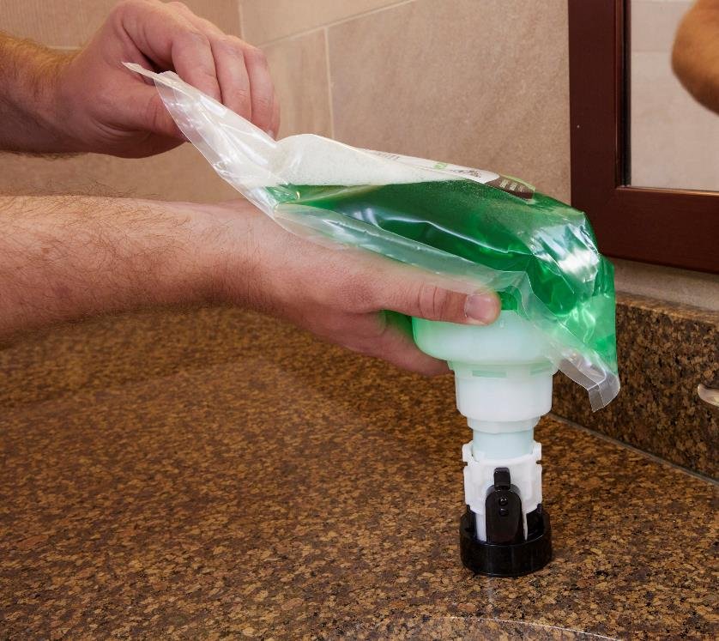



Differentiators
Labor Efficiencies
Image Enhancement
Cost Savings
Safety and Health
Notes:
What sets our TOPFILL system apart from other in-counter dispensers on the market?
Labor efficiencies:
Eliminates need to crawl underneath the counter or on the floor – dignity of cleaning staff
No need to remove ADA paneling – saves time!
Above counter systems take significantly more time refill – at least THREE TIMES that of our patented topfill system (approximately one minute/dispenser vs. three)
Image enhancement:
Nice chrome finish in a styling that's more consistent with what you would find in modern restrooms today
No touch conveys a facility’s commitment to healthy and clean environment
Three LUX soap refill options that provide an upscale hand washing experience
Cost savings for facilities:
To start, the dispenser itself: Kutol’s dispenser is ONE FOURTH
LUX refill bags evacuate 100% = 5 to 10% product savings
A lot of building service contractors get graded on product stock out so if they take the time to crawl under the counter, remove the panel and see that there's an additional soap left in the refill, but it's getting close to the end, they'll just take it out, swap it and throw it away. Very costly for facility.
Patented dock system = no product spills or waste that occurs with bulk pour systems
Safety and health:
OSHA recommends reducing repetitive motions and routine hazards for a safer working environment.
TOPFILL is an effective solution by eliminating repeated, unhygienic under counter servicing
No need to remove ADA panels that can be quite heavy.
No touch minimizes the spread of germs in a facility

Slide 5
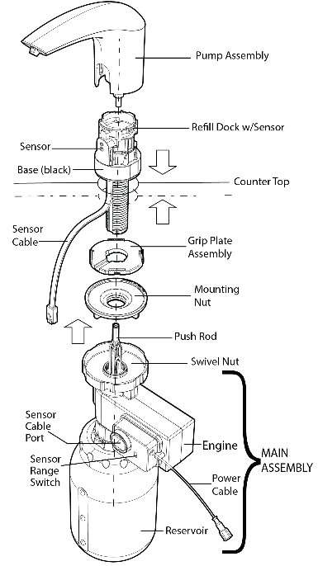
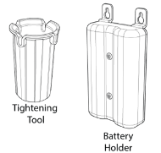
Features
.6 mL of soap per hand wash
1200 mL refill bags = 2,000 hand washes
1500 mL canister capacity
4 D cell batteries = at least 40,000 hand washes
Notes:
Features of the dispenser you’ll want to know

Slide 6
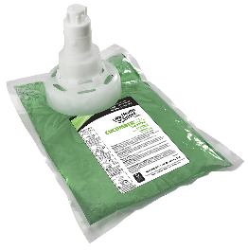
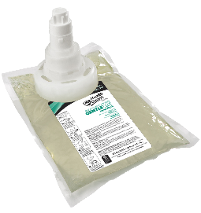
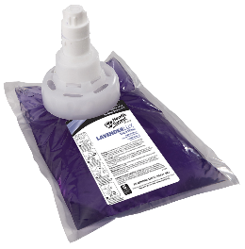

Features: Refills
LUX Refills
Sealed, sanitary, locking
2,000 handwashes
1200 mL, 3 per case
CucumberLUX
Refreshing cucumber scent
GentleLUX
Dye and fragrance free
LavenderLUX
Mild lavender scent
Notes:
New formulas from Health Guard have been branded “LUX” to convey the elevated handwashing experience they provide – extra soft with high foaming
Sealed and sanitary
2000 handwashes per one 1200 mL refill bag
All three are ECOLOGO certified
WORK ONLY in the NO TOUCH dispenser – refills are NOT interchangeable with the manual counter mount
Reasoning for no antibacterial offering: antibac formulas are typically not compatible from a chemistry standpoint with non antibacterial products so if a facility ever made a decision to change from one to the other, changing out is very challenging. If do switch, creates an unfortunate experience with the reservoir being filled with a soap that would look more brown than clear.
Triple S offers an exclusive fragrance in lieu of Cucumber = Citrus Reserve
Only one fitment, requires market protection/policing.

Slide 7
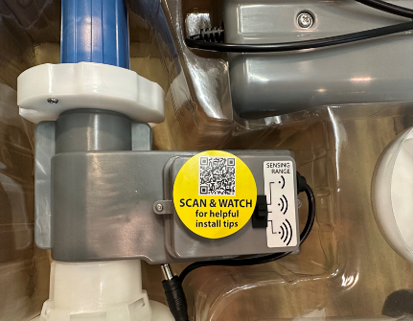
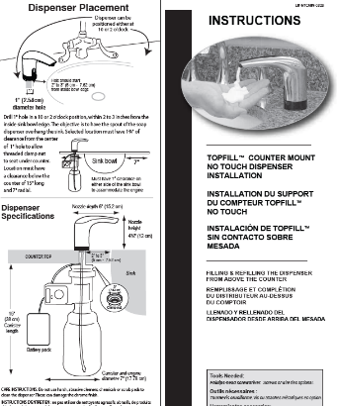
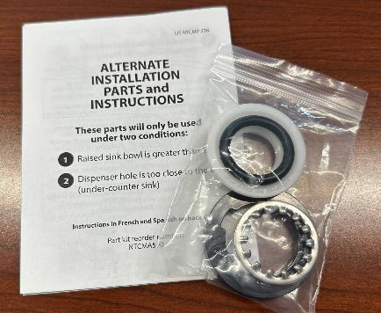
Installation
Hard copy instructions in each package
QR code sticker on each dispenser
Alternate parts also included
Following the installation instructions is critical to the successful function of the dispenser.
Notes:
Hard copy instructions included with every dispenser
“Scan and watch” sticker on each dispenser goes to installation video
Alternate parts for use in specific scenarios:
Tight area under sink
Raised sink bowl
Thick countertop
Any combo of the above

Slide 8
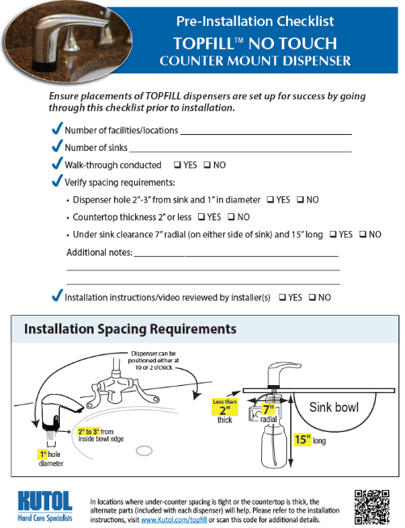
Pre-Install
Best Practices
Conduct walkthrough
Note number of (facility) locations
Note number of sinks
Verify spacing requirements
        Dispenser hole 2”-3” from sink, 1” in diameter
        Countertop thickness 2” or less
        Under sink clearance: 7” radial, 15” long
Encourage installers to review instructions and video
https://www.kutol.com/wp-content/uploads/2023/10/NTCM_Presale-Site-Survey.1023-fillable.pdf
Notes:
To assist in a successful installation, there are some pre-install best practices you can follow.
Pre-install checklist is on website – use as guide when visiting facility or prior to install.

Slide 9
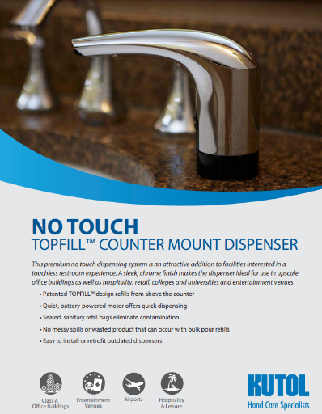
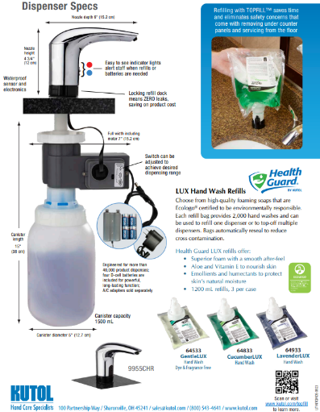
Selling Tools
Sales Flyer
https://www.kutol.com/wp-content/uploads/2023/09/TOPFILL-No-Touch-Counter-Mount-Flyer_0923.pdf
Notes:
One page flyer dedicated to NTCM – available for order as hard copy or download online

Slide 10
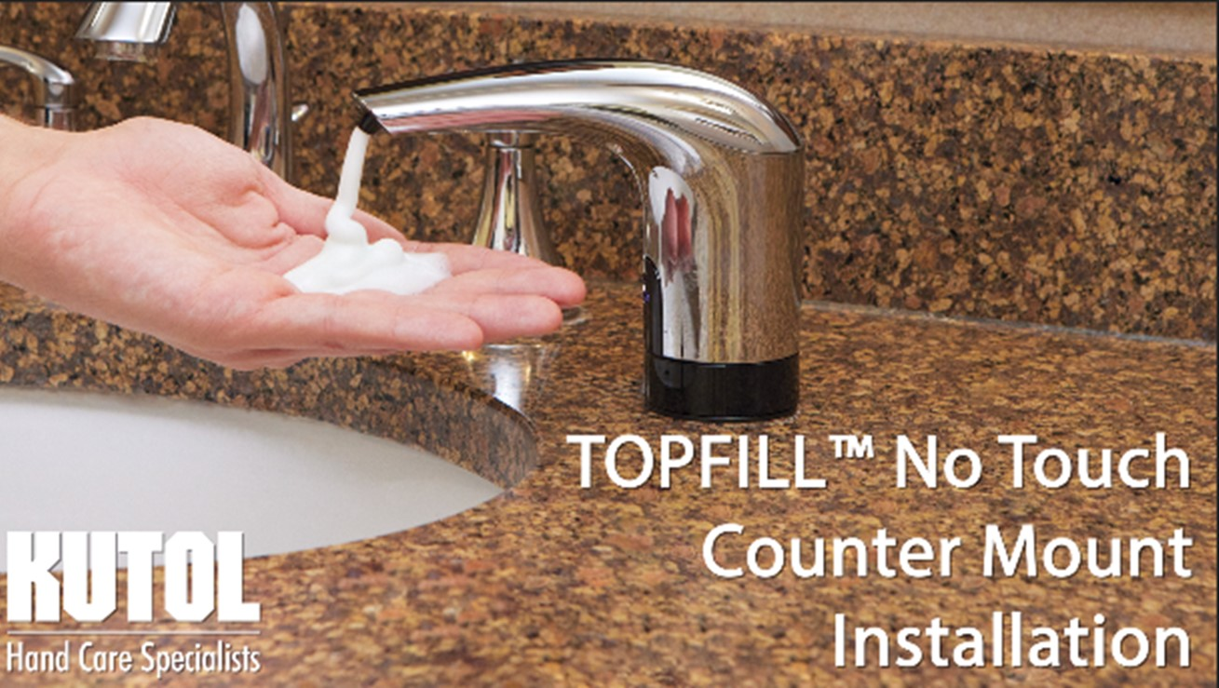
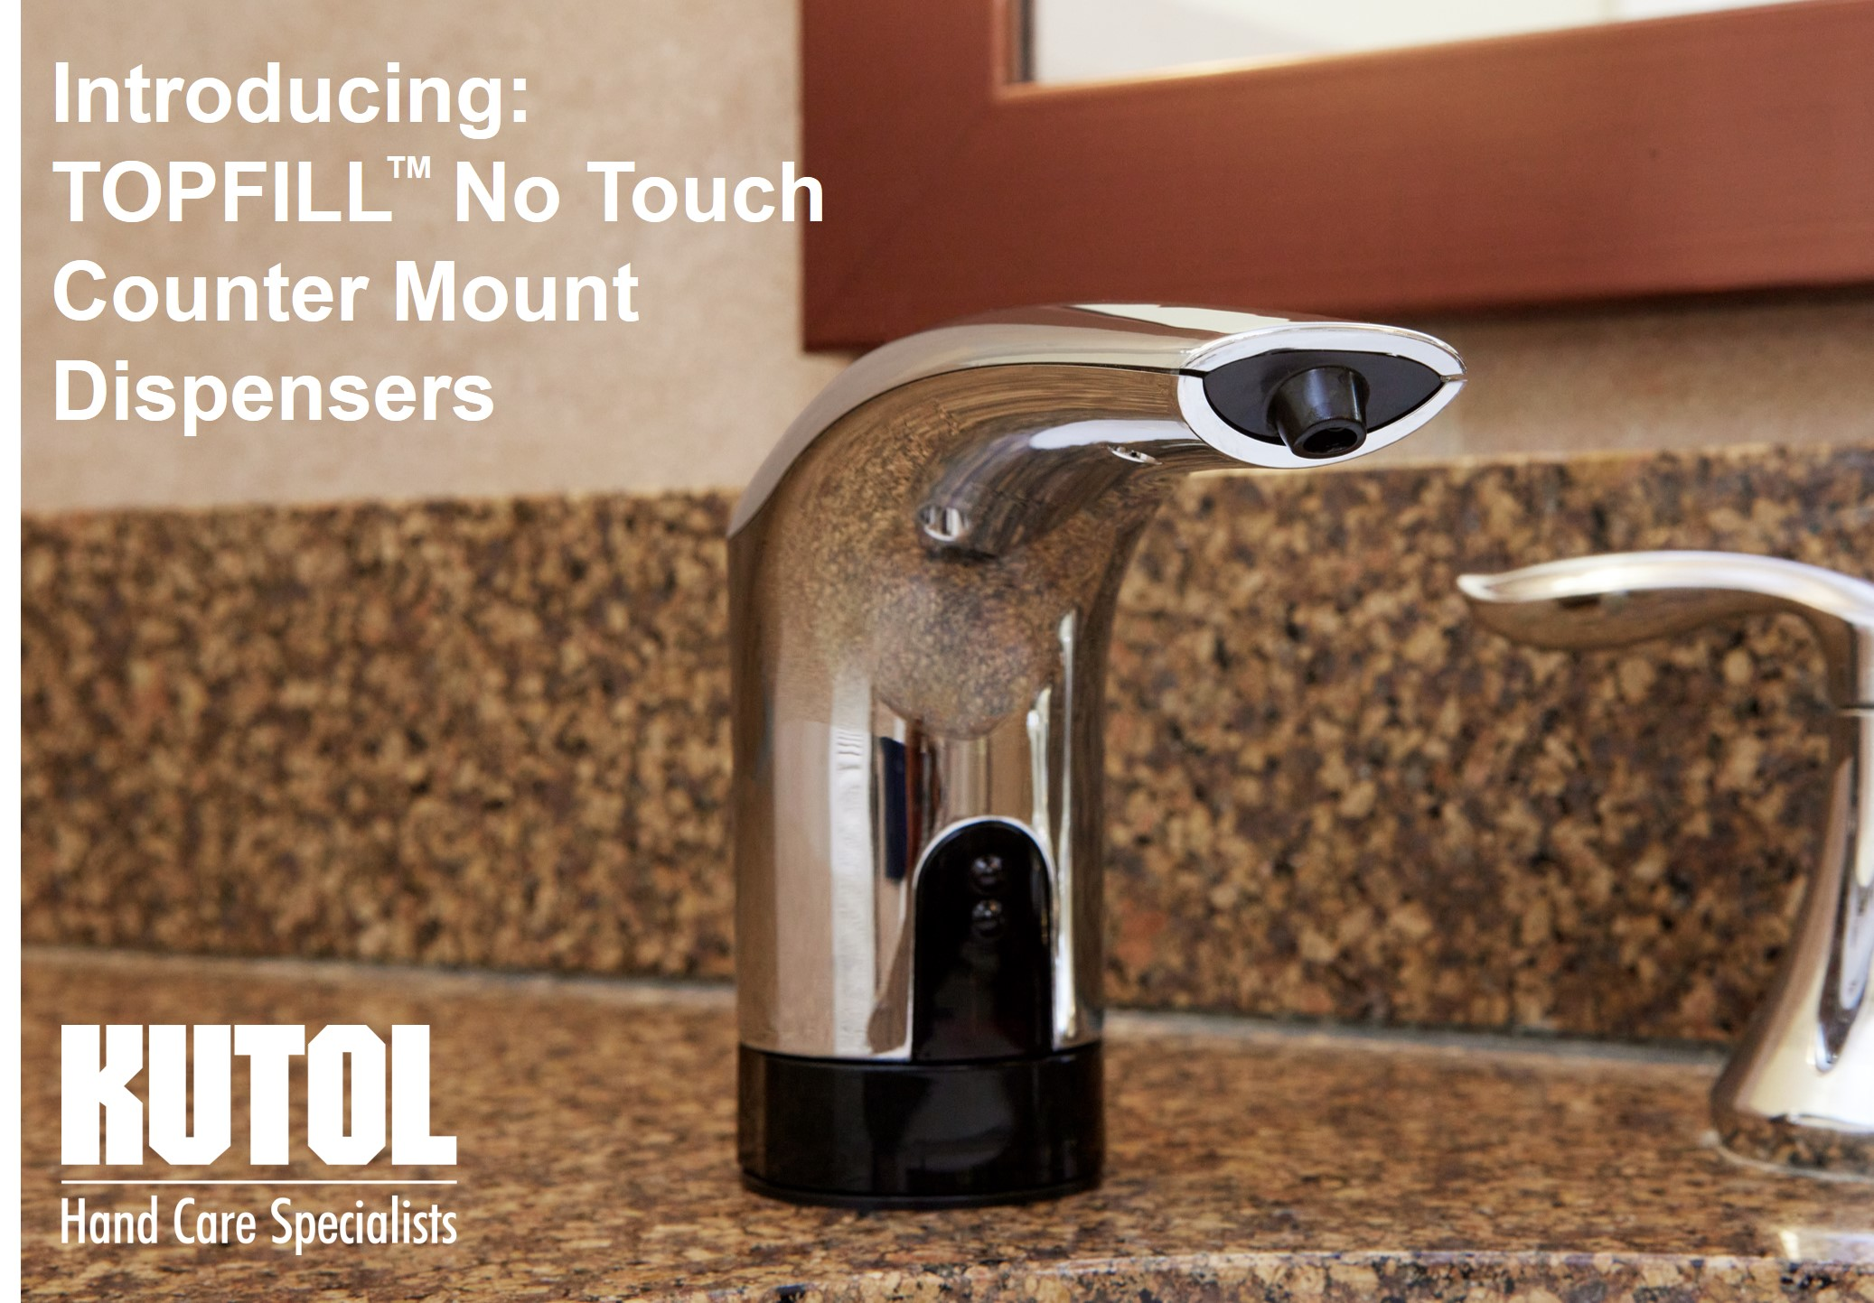
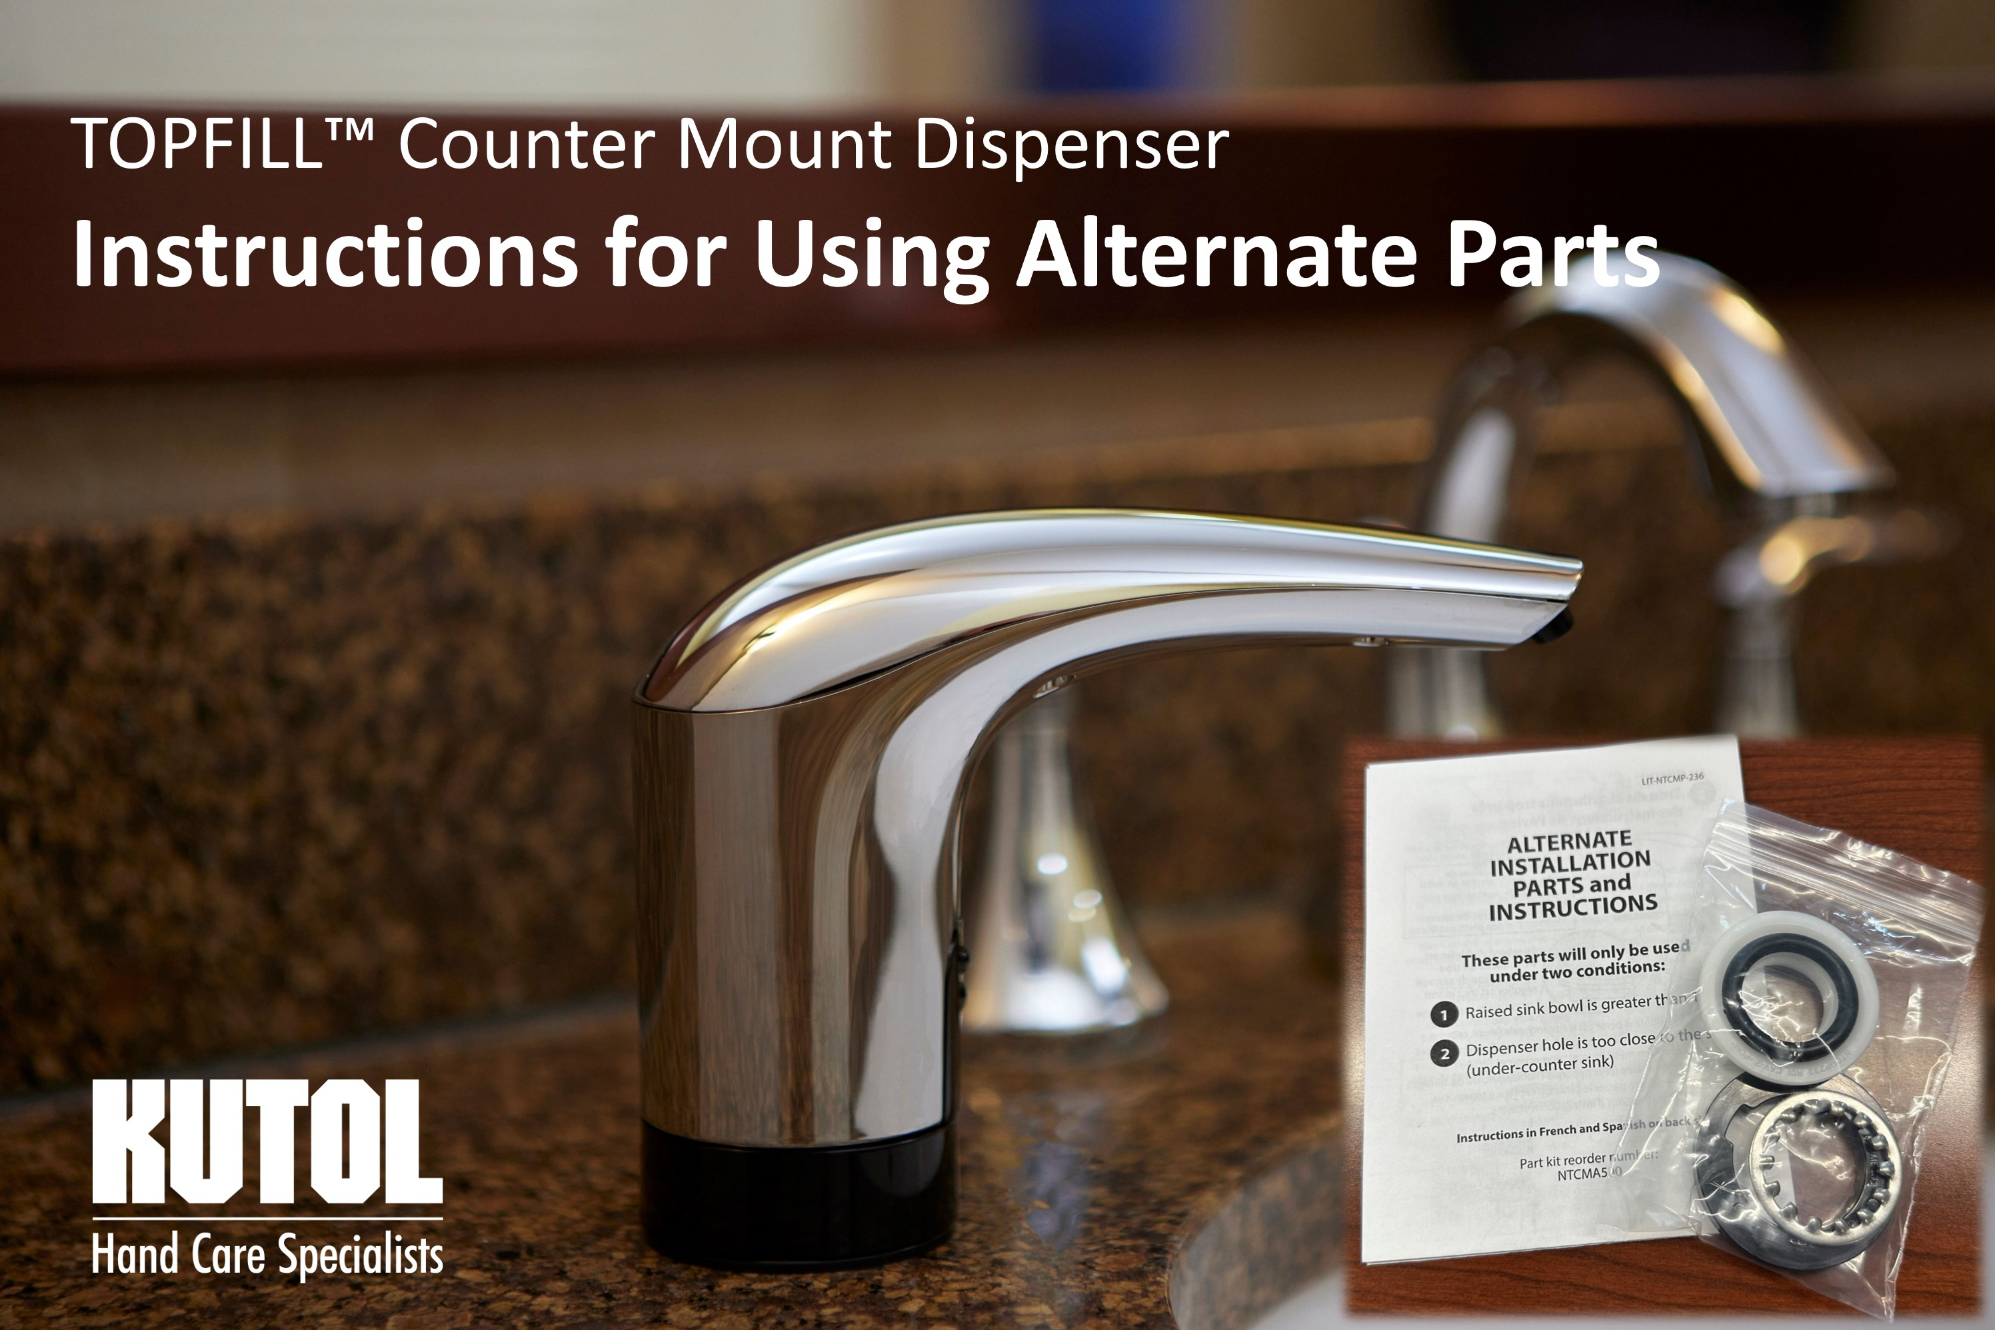
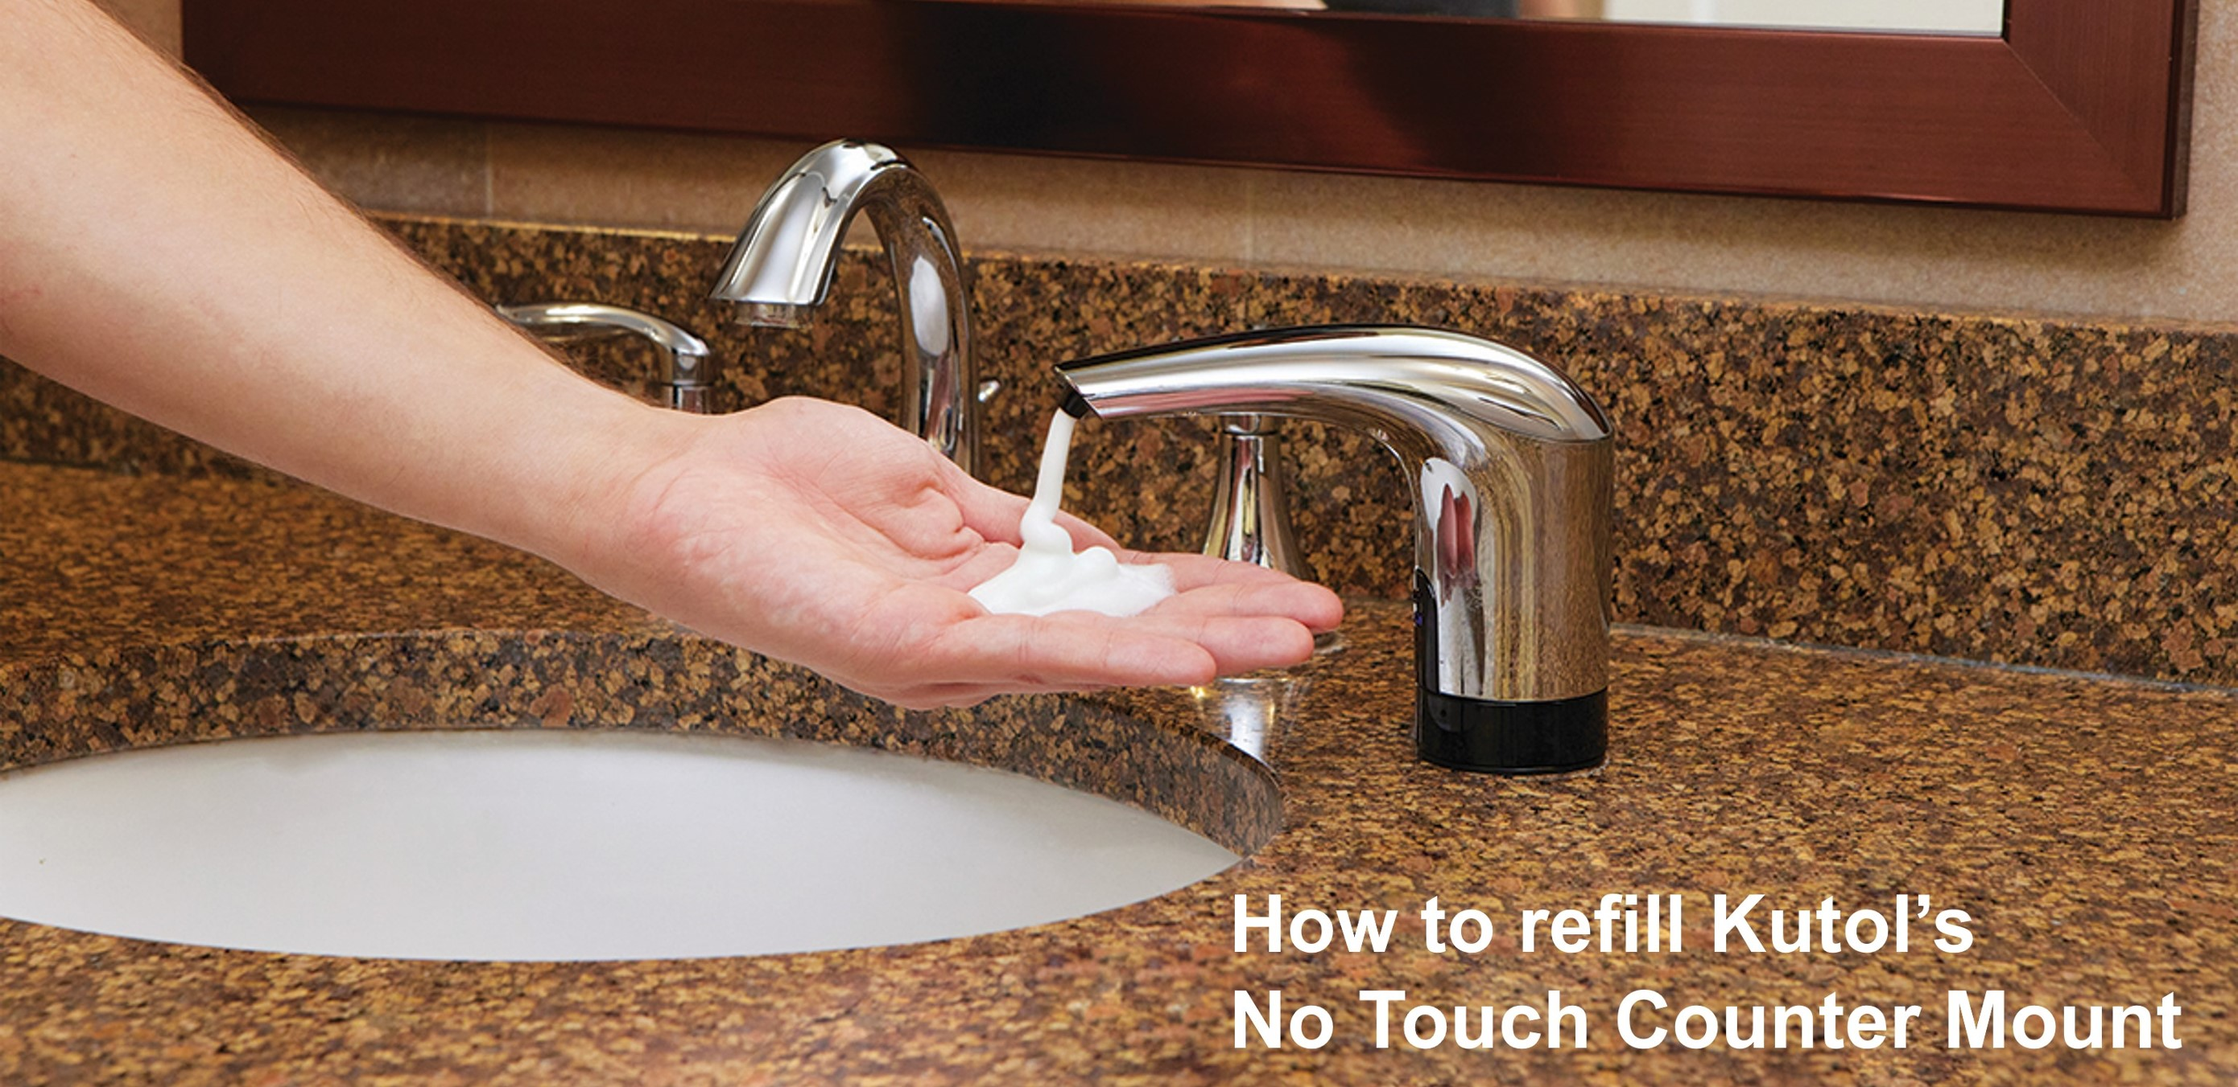
Videos
Notes:
Not going to play all of the videos available – we shared them during our initial training but as a reminder: all videos are on Kutol’s YouTube Chanel:
Minute and a half marketing video
Instructional videos for:
Installation
Alternate Parts
Refilling

Slide 11
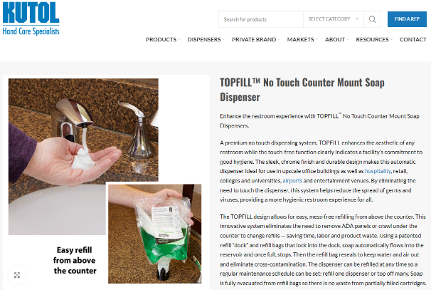
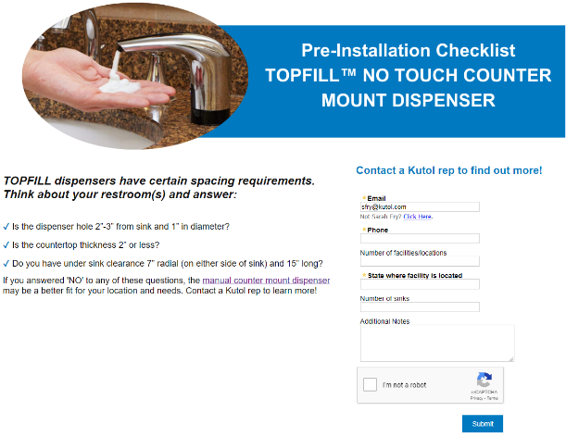

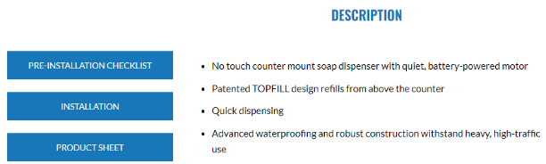
Online Checklist / Lead Capture
go.kutol.com/no-touch-counter-mount-preinstallation-checklist
Notes:
This online form is available to capture leads – refer/use it with customers as a) pre-install checklist and b) initiate the sales process
When the form is submitted, the info will be transferred to Kutol for follow-up and next steps

Slide 12



Quick Links
Digital
Collateral
Web Page
Lead Capture
YouTube Playlist:
        Marketing Video
        Installation Video
        Refilling Video
        Alternate Parts Video
Sales Flyer
Brochure
Advantages Flyer
FAQ
Pre-Install Checklist
Scan and save!
Notes:
Links to the sales tools and videos
Scan the QR code for the no touch counter mount page on our website

Slide 13






Opportunities
Hospitality & Leisure
Airports
Class A Office
Entertainment Venues
Commercial Real Estate
Notes:
These are prime opportunities you should be targeting with NTCM – great fits because of the volume/traffic as well as the differentiators we identified earlier. These facility types place great value on:
Labor efficiencies
Product cost savings
Image enhancement
Health and safety

Slide 14
Opportunities: Understanding Key Players
Building Owner
Property Manager
Building Service Contractor
Building Engineer
Commercial
Real Estate
Tenants
Notes:
Some of the most important players you’ll interact with on this system are within commercial real estate.
Let’s dive a little deeper into who does what in this space and what is most important to them.
Property Manager – KEY PLAYER in the equation and the most important person to know to make something happen. Controls all aspects of the building and reports directly to the owner. Can make most daily decisions without approval and is in contact with all related parties. Job is to attract and retain tenants and get the highest amount of rent per square foot possible. Will invest in improvements if it increases the stature of their building in relation to similar properties thus driving up base rent rates.
Building Owner – not involved in the day-to-day. Can be a large institutional investor or a local investor or group. Is usually a passive investor looking for a return on the investment.
Building Engineer – Will often have a say in anything related to maintenance, plumbing, electrical and other aspects necessary to keeping the building functioning properly and efficiently.
Building Service Contractor – In addition to cleaning the building, proactive in offering solutions and upgrades to the facility. Reports directly to the property manager and has intimate knowledge of the building and a vested interest in the building’s upkeep and improvements.
Tenants – Sometimes drive the PM to make improvements in order to retain them when a lease is up for renewal or as a function of their initial build-out budget.

Slide 15
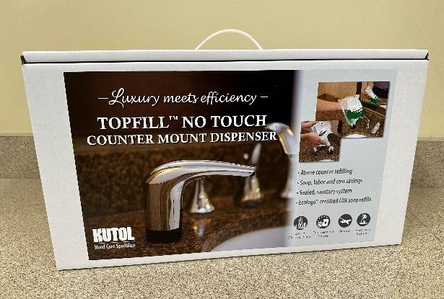
Who are your opportunities?
Target list for demos?
Building Service Contractor targets?
Notes:
Who are you identifying as targets?
Demo kit
BSC targets – communicate this to your Kutol sales manager

Slide 16
End User Trial
60
4
1
Day risk-free trial for facility to decide to keep dispenser (pay invoice) or return (no cost)
Dispensers per facility maximum
Refill bag per dispenser provided at no charge
Notes:
Trial program – great opportunity for key end users to experience the benefits of TOPFILL in their facility.
60 day trial period, at which point the facility can decide to keep the dispensers and pay $98/dispenser. Or return the dispensers at no cost to them.
There is a 4-dispenser limit per facility and Kutol will provide one refill bag per dispenser. Additional refills can be ordered.

Slide 17
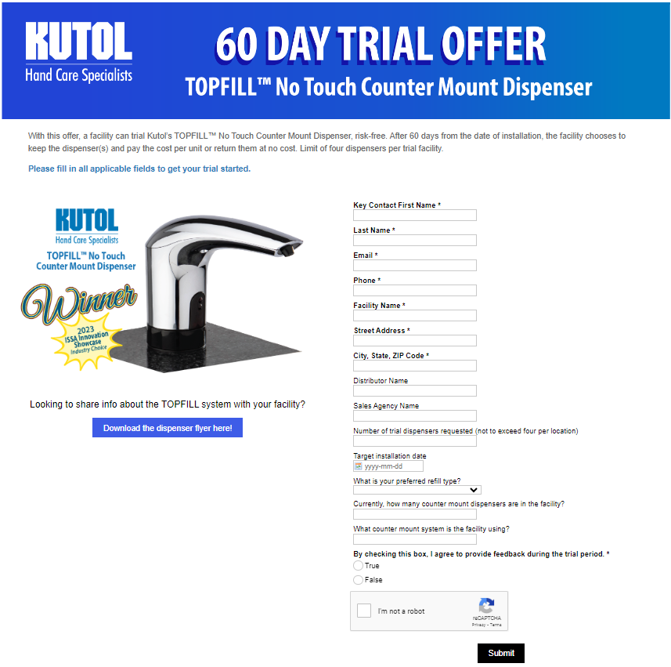
End User Trial Form
Notes:
To participate – facility completes online trial form then Kutol will coordinate.
Installation must take place with sales agent present
Sales rep checks in and collects feedback from facility every two weeks
https://go.kutol.com/no-touch-counter-mount-trial-offer

Slide 18
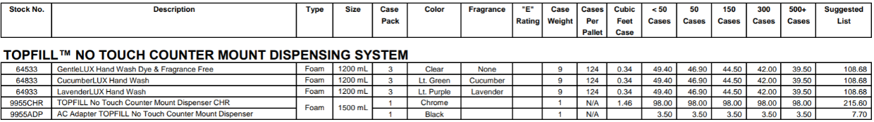

Pricing
CONFIDENTIAL: FOR INTERNAL USE ONLY.

Slide 19
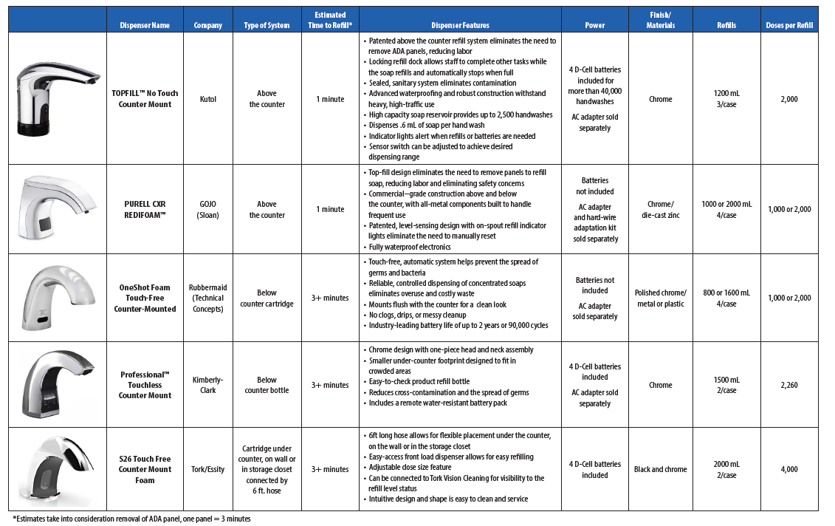
Competitor Comparison
CONFIDENTIAL: FOR INTERNAL USE ONLY.
Notes:
We’ve gone through the process of comparing several no touch counter mount dispenser systems and here’s what we’ve learned:
Of the two topfill systems on the market (Kutol and Gojo), Kutol’s dispenser is ONE FOURTH the cost of Gojo’s
Other systems on the market take significantly more time refill – at least THREE TIMES that of Kutol’s TOPFILL system (approximately one minute vs. three)
Get info from John W. on per shot costs, etc.
As you come up against competitor systems in the field and gain additional intel, share that with Kutol so we can build out this comparison.
This document is available to you and will be emailed as a follow-up to this presentation. It is for your use only and should not be distributed.

Slide 20

Monthly Leaderboard Email
Notes:
Yes, we will be tracking your NTCM placements!
And just like the DECO placement program – we will be updating our agencies with a monthly leaderboard email. Don’t be one of the agencies that never makes it into the top five…

Slide 21
Value Prop
Maximize labor efficiency and reduce soap costs while enhancing the health and prestige of a facility with TOPFILL.
Notes:
One last review of the value prop of the TOPFILL system. Happy selling!

